Slide 1




WELCOME
1st (35^{th)} IQAC Meeting
Wednesday, 11th Dec 2024

Slide 2
Agenda
Action taken report on the proposals of 34th IQAC meeting
Viksit Bharat @ 2047 – Role of Indian Universities.
Promotion of Inter-departmental/Multi-disciplinary research among Engineering and Non-Engineering departments for addressing societal challenges for comprehensive solutions.
Open for discussion
Strengthening outreach programs for community development through national schemes
Advancing industry-institute relation through translational research
Any other item with permission of chairperson.

Slide 3
Action taken report on the proposals of
34th IQAC meeting
Viksit Bharat @ 2047 – Role of Indian Universities
Objective of Viksit Bharat
  Basic amenities
  Opportunities for growth and quality life for every person in the country
  Manpower to turn the India into manufacturing hub
It is a great opportunity to Siddhartha university to excel at national level.

Slide 4
Action taken report on the proposals of 34th IQAC meeting
Promotion of Inter-departmental/multidisciplinary Research among Engineering Departments
Several strategies were proposed in 34th IQAC meeting
  Identifying common goals and priorities between departments
  Establishing collaborative labs
  Developing inter departmental research teams
  Creating shared R&D facilities
  Provide joint research seed grants and seek external funding

Slide 5



Issues Open for Discussion
Strengthening outreach programs for community development through national schemes
Advancing industry-institute relation through translational research
Any other with permission of chairperson

Slide 6


Strengthening Outreach Programs for Community Development through National Schemes
To address Social, Economic and Environmental problems
To bring Academics and Communities closer.
To support Sustainable Development and Empower Underprivileged Groups
To increase the Institution's Role in helping Society

Slide 7
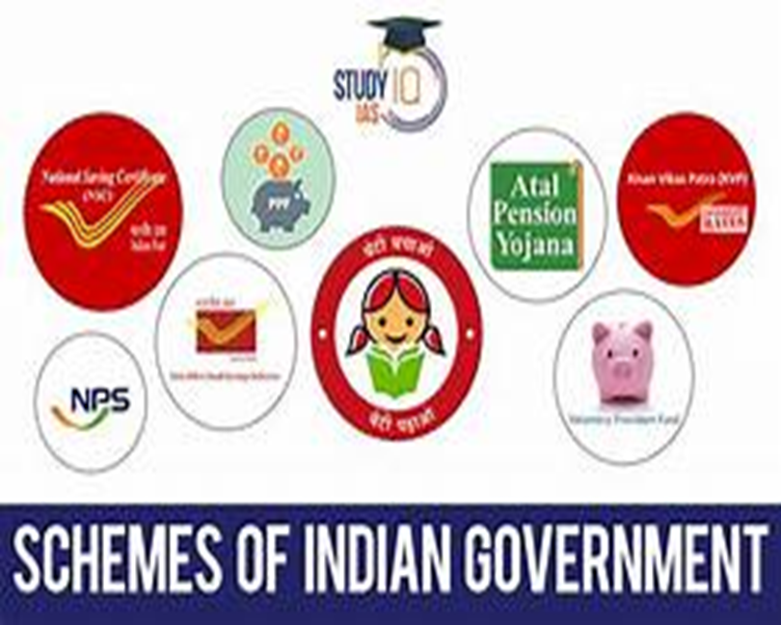
National Schemes Associated with Outreach Programs
To address various Societal Challenges with focus on Education, Health, Skill development, Environmental Conservation and Empowerment.

Slide 8
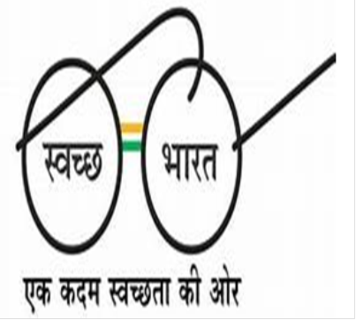

Swachh Bharat Abhiyan (Clean India Mission)
Focus Area: Cleanliness, sanitation, and waste management.
Activities:
Organizing cleanliness drives in villages and urban areas.
Awareness on Hygiene and Sustainable Waste practices.
Constructing Toilets and improving Sanitation.
Unnat Bharat Abhiyan
Focus Area: Rural development through Academic Expertise.
Activities:
Adoption of Villages to address local issues like education, health, and water conservation.
Providing Sustainable Technological solutions to Rural Challenges.
Conducting surveys to Identify and solve Developmental needs.

Slide 9

Digital India Initiative
Focus Area: Digital Literacy and e-governance.
Activities:
Training communities in using Smartphones, Online banking, and Digital Payment systems.
Setting up Digital Literacy Camps for rural populations.
Educating citizens about accessing Online Government services.
Skill India Mission
Focus Area: Skill Development and Vocational Training.
Activities:
Conducting Workshops and Training in areas like IT, Agriculture and Handicrafts.
Providing Certification under recognized Skill Development frameworks.

Slide 10
Jal Shakti Abhiyan
Focus Area: Water Conservation and Management.
Activities:
Conducting Water Conservation Awareness Campaigns.
Promoting Rainwater Harvesting and Efficient Irrigation methods.
Implementing Water-Saving Technologies in rural areas.
Pradhan Mantri Kaushal Vikas Yojana (PMKVY)
Focus Area: Skill Development for Employment.
Activities:
Organizing Short-term Skill Training programs.
Encouraging Self-employment and Entrepreneurship
Collaborating with industries for On-The-Job training opportunities.

Slide 11
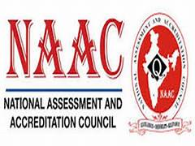
Relevant NAAC Metrics for Outreach Programs
Why These Metrics Matter?
Institution’s Social Responsibility and Community Engagement.
Integration of Academic Knowledge with Practical Societal applications.
Role of Students and Faculty in Sustainable Community Development.

Slide 12
Criterion III: Research, Innovations, and Extension
3.4.1 Extension and outreach programs conducted in collaboration with industry, community, and Non-Governmental Organizations (NGOs).
Weightage: 20 marks
Assesses the institution’s efforts in addressing societal needs through partnerships.
3.4.2 Number of students participating in extension activities at State, National, and International levels.
Weightage: 10 marks
Evaluates student involvement in outreach programs.
3.4.3 Impact of outreach activities on community development.
Weightage: 20 marks
Focuses on measurable benefits and societal impact of the programs.
3.4.4 Awards/recognitions for extension activities from government/recognized bodies.
Weightage: 10 marks
Rewards institutions for recognized contributions to extension and outreach.

Slide 13
Criterion VII: Institutional Values and Best Practices (100 Marks Total)
7.1.9 Sensitization of students and employees to constitutional obligations.
Weightage: 10 marks
Highlights programs that promote civic responsibility and constitutional awareness.
7.1.10 Code of conduct and citizenship training programs.
Weightage: 5 marks
Assesses the institution’s efforts in ethical and responsible citizenship training
7.2 Best Practices
Weightage: 30 marks
Recognizes innovative and impactful outreach programs as part of best practices.
7.3 Institutional Distinctiveness
Weightage: 20 marks
Institutions unique outreach activities that align with their mission and vision.

Slide 14
Total Marks for Outreach-Related Metrics
Criterion III: Extension Activities: 60 marks
Criterion VII: Institutional Social Responsibility: 65 marks
Overall Impact on NAAC Assessment: 125 marks

Slide 15
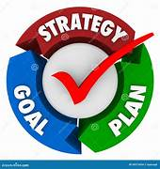
Implementation Strategy for Outreach Programs inline with NAAC
Community Need Assessment
Set specific, measurable, achievable, relevant, and time-bound goals
Plan impactful activities of community needs.
Implement activities with community engagement
Monitoring and Evaluation
NAAC Alignment

Slide 16
Outreach Activities for CSE, IT and MCA Departments
Timeline for Completion:3 months
Activity | Implementation Steps | National Scheme Mapping | Target Audience
Organize coding bootcamps for high school students in rural areas. | 1. Design beginner-friendly coding lessons. 2. Partner with schools for participation. | Digital India, Skill India | High school students in rural and underserved areas
Develop mobile applications to solve local governance challenges. | 1.Identify governance issues with local authorities. 2. Develop and deploy simple apps. | Smart Cities Mission, Digital India | Local government authorities, community members
Conduct cybersecurity awareness workshops for the community. | 1. Collaborate with experts to conduct workshops. 2. Distribute online safety manuals. | Cyber Surakshit Bharat, Digital India | Community members, especially youth and small business owners
Create IoT-based smart solutions for water management. | 1. Develop IoT prototypes for monitoring water usage. 2. Demonstrate in local communities. | Jal Shakti Abhiyan, Digital India | Local farmers, municipal water management bodies
Provide digital literacy training to rural youth and women. | 1. Train participants in basic computer and internet usage. 2. Collaborate with NGOs for outreach. | Digital India, Beti Bachao Beti Padhao | Rural youth, women, and senior citizens
Host hackathons to design solutions for local problems. | 1. Invite students and professionals to participate. 2. Award the best solutions with incentives. | Startup India, Digital India | University students, local entrepreneurs, and tech enthusiasts

Slide 17
Activity | Implementation Steps | National Scheme Mapping | Target Audience
Assist in Digitalizing Small Businesses | 1. Train shop owners to use digital payment systems. 2. Create simple inventory management tools. | Digital India, Make in India | Small shop owners and entrepreneurs in rural/urban areas
Develop E-Governance Solutions | 1. Partner with local bodies to identify key governance challenges. 2. Develop a user-friendly portal. | Digital India, Smart Cities Mission | Municipal bodies and local government officials
Tech Support for Schools | 1. Help local schools upgrade their IT infrastructure. 2. Conduct basic IT training for teachers. | Digital India, National Education Policy | Teachers and administrators of local schools
AI for Agriculture | 1. Develop simple AI models for predicting crop health. 2. Provide workshops for farmers on usage. | Digital India, Unnat Bharat Abhiyan | Farmers in rural areas
IT Accessibility for Differently-Abled Individuals | 1. Design apps or tools to improve accessibility. 2. Conduct workshops on assistive technology. | Accessible India Campaign, Digital India | Differently-abled individuals

Slide 18
Outreach Activities for MBA Department
Timeline for Completion:3 months
Activity | Implementation Steps | Target Audience | National Scheme Mapping
Financial Literacy Workshops | Conduct sessions on savings, investments, and government financial schemes. | Villagers, small business owners, and youth | Pradhan Mantri Jan Dhan Yojana, Digital India
Entrepreneurship Awareness Programs | Organize seminars on starting small-scale businesses with local resources. | Youth and small-scale business aspirants | Skill India Mission, Make in India
Skill Development for Women Entrepreneurs | Provide training on basic business management for women entrepreneurs. | Women entrepreneurs and self-help groups | Beti Bachao Beti Padhao, Skill India Mission
Digital Marketing Training for Local Businesses | Teach local shop owners and artisans to use social media for marketing. | Local shop owners and artisans | Digital India, Make in India
Career Guidance and Mentorship Sessions | Guide students and youth on career paths and job opportunities. | School and college students, and unemployed youth | Skill India Mission, National Education Policy

Slide 19
Outreach Activities for Humanities Department
Timeline for Completion:3 months
Activity | Implementation Steps | Target Audience | National Scheme Mapping
Community Storytelling for Literacy | Encourage storytelling sessions in schools and community spaces to boost literacy. | School children and illiterate adults | National Literacy Mission, Unnat Bharat Abhiyan
Life Skills Development Workshops | Conduct workshops on communication, time management, and conflict resolution. | Youth and women in rural areas | Skill India Mission
Awareness Campaigns on Civic Duties | Distribute pamphlets and conduct seminars on voting rights and civic responsibilities. | Villagers and community leaders | Digital India, National Voter Awareness Program
Emotional Well-being and Stress Management | Organize group sessions focusing on mental health and stress-relief techniques. | School children and community members | National Health Mission

Slide 20
Outreach Activities for EIE Department
Timeline for Completion:3 months
Activity | Implementation Steps | Target Audience | National Scheme Mapping
Training on Low-Cost Automation for Agriculture | Demonstrate basic automation techniques for irrigation and crop monitoring using low-cost sensors. | Farmers and agricultural workers | Digital India, Skill India Mission
Workshops on Basic Instrumentation Usage | Provide hands-on training on using and maintaining basic instrumentation like pressure gauges and thermometers. | Local technicians and youth | Skill India Mission
Community Safety Training on Electrical Devices | Conduct sessions on safe handling and maintenance of electrical devices in households. | Village residents and school students | Cyber Surakshit Bharat, National Health Mission
DIY Solar Lantern Demonstration | Teach villagers to create solar lanterns using locally available materials. | Households in areas with unreliable electricity | National Solar Mission
Awareness on Energy Conservation Techniques | Educate villagers on simple energy-saving practices such as efficient use of appliances. | Rural households and shop owners | Energy Efficiency Mission, Unnat Bharat Abhiyan

Slide 21
Outreach Activities for EEE Department
Timeline for Completion:3 months
Activity | Implementation Steps | Target Audience | National Scheme Mapping
Energy-Saving Awareness Campaigns | Conduct door-to-door awareness or group sessions on energy-saving practices. | Rural households and shop owners | Energy Efficiency Mission
Electrical Safety Workshops | Educate villagers on safe usage of electrical appliances and handling wires. | Village residents and school students | Cyber Surakshit Bharat, National Health Mission
DIY Solar Cooker Training | Train villagers to create solar cookers using locally available materials. | Rural households | Unnat Bharat Abhiyan
Energy Audits for Local Buildings | Perform energy audits of schools and community centers to suggest savings. | Local authorities and community centers | Energy Efficiency Mission
Skill Development in Basic Wiring | Organize workshops to teach basic wiring and repair skills. | Local youth | Skill India Mission
Awareness on Renewable Energy | Educate communities about renewable energy and demonstrate simple applications. | Local households and schools | National Solar Mission
Campaigns on Responsible Energy Usage | Highlight the importance of reducing energy wastage through campaigns. | Villagers and small business owners | Energy Efficiency Mission
DIY LED Light Assembly Workshops | Teach villagers to assemble LED lights using low-cost materials. | Local electricians and students | Make in India
Digital Education on Electrical Safety | Leverage free online resources to educate on safety and energy conservation. | School students and youth | Digital India
Community Support for Basic Electrical Repairs | Fix simple electrical devices for free using existing institutional tools. | Rural households | Skill India Mission

Slide 22
Outreach Activities for ECE Department
Timeline for Completion:3 months
Activity | Implementation Steps | Target Audience | National Scheme Mapping
IoT for Smart Farming Demonstrations | Demonstrate IoT-based systems for monitoring soil moisture and crop health. | Farmers and agricultural workers | Digital India, Unnat Bharat Abhiyan
Awareness on Digital Communication Tools | Conduct sessions on using mobile apps and communication tools for better connectivity. | Youth and community leaders | Digital India, Smart Cities Mission
Workshops on Low-Cost Electronic Devices | Teach villagers to assemble and use affordable electronic devices like LED lights. | Local electricians and youth | Make in India, Skill India Mission
Community Training on Solar-Powered Systems | Showcase the setup and usage of solar-powered lights and chargers. | Households and small businesses | National Solar Mission, Digital India
Educational Camps on Digital Literacy | Provide hands-on training for using smartphones, internet services, and e-governance platforms. | Students and senior citizens | Digital India, National Education Policy

Slide 23
Outreach Activities for CIVIL Department
Timeline for Completion:3 months
Activity | Implementation Steps | Target Audience | National Scheme Mapping
Awareness on Rainwater Harvesting | Organize sessions to educate villagers on rainwater harvesting methods using local materials. | Farmers and rural households | Jal Shakti Abhiyan, Unnat Bharat Abhiyan
Low-Cost Housing Design Education | Teach low-cost, sustainable housing designs using easily available resources. | Local masons and villagers | PMAY (Pradhan Mantri Awas Yojana), Skill India Mission
Community Workshops on Sanitation | Conduct workshops on building and maintaining household toilets for better sanitation. | Households and women groups | Swachh Bharat Abhiyan
Road Safety Awareness Campaigns | Raise awareness about road safety measures and distribute reflective stickers for vehicles. | Vehicle owners and school children | National Road Safety Program
Village Mapping for Infrastructure Improvement | Involve students in mapping village infrastructure to identify improvement areas. | Village panchayat and local leaders | Unnat Bharat Abhiyan, Smart Cities Mission

Slide 24
Outreach Activities for MECH Department
Timeline for Completion:3 months
Activity | Implementation Steps | Target Audience | National Scheme Mapping
Workshops on Low-Cost Agricultural Tools | Conduct hands-on sessions for farmers on creating simple agricultural tools. | Farmers and rural workers | Skill India Mission, Make in India
Awareness on Fuel Efficiency Practices | Educate vehicle owners and farmers on fuel-saving techniques and practices. | Vehicle owners and farmers | Energy Efficiency Mission
Demonstration of Water Pump Maintenance | Showcase maintenance techniques for water pumps to enhance durability. | Farmers and local mechanics | Jal Shakti Abhiyan, Skill India Mission
Training on Repair of Basic Machinery | Organize training sessions for youth on repairing basic agricultural and household machinery. | Youth and aspiring mechanics | Skill India Mission
DIY Biogas Plant Demonstration | Demonstrate the setup of a small-scale biogas plant using household waste. | Farmers and households | National Biogas and Manure Management Program

Slide 25


Outcomes
Community welfare through Education, Healthcare and Resource Access
Empower Underprivileged Groups, Women and Youth with skills and opportunities
Problem-solving, Leadership and Teamwork Skills among students and faculty.
Adoption of Sustainable Practices like water conservation and energy efficiency
Institutional Reputation as a socially responsible organization
Impact
Benefits to Underserved Communities, reducing social inequalities
Real-life Exposure and practical knowledge for students
Contribution to national schemes like Digital India and Swachh Bharat Abhiyan
Improved NAAC Accreditation scores and Institutional Growth

Slide 26
Advancing Industry-Institute Relations through Translational Research

Slide 27
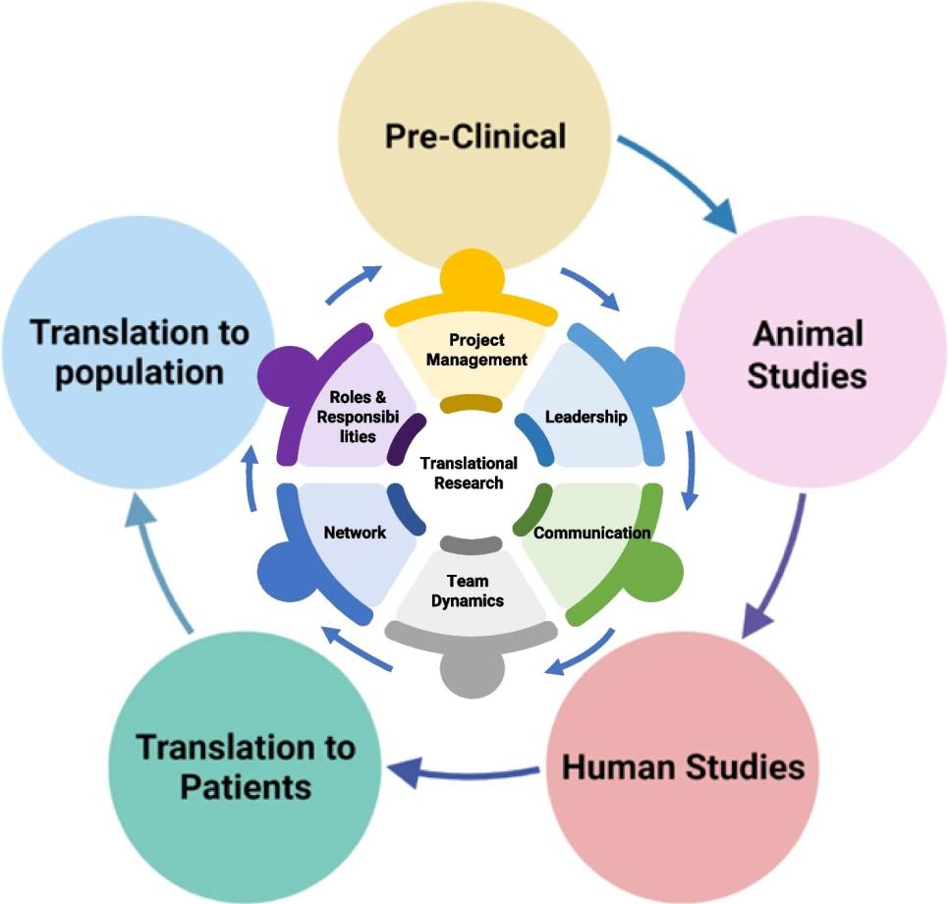
Advancing Industry-Institute Relations through Translational Research
To bridges the gap between Academic Knowledge and Practical Applications
To foster a strong relationship between Industries and Academic Institutions
Transforming Theoretical discoveries into Real-world Solutions benefiting both Academia and Industries.

Slide 28
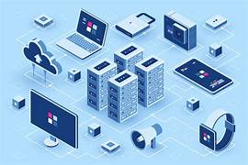

Implementation Strategy for Industry-Institute Relations through Translational Research
Create Joint Labs where researchers and Industry Experts solve Real-world Problems together.
  High-Performance Computing (HPC) Lab
  Advanced Robotics and Automation Lab
  Quantum Computing Lab
  Cybersecurity Lab
  Renewable Energy and Sustainability Lab
  Advanced Materials Research Lab
  Structural Engineering and Earthquake Simulation Lab
  Computational Fluid Dynamics (CFD) Lab
  Advanced Electronics and VLSI Design Lab
  Additive Manufacturing and 3D Printing Lab
  Autonomous Vehicles and Control Systems Lab

Slide 29


Implementation Strategy for Industry-Institute Relations through Translational Research
Industry-based projects, internships, and hackathons in student activities.
Organize summits and workshops to connect researchers with industry leaders.

Slide 30

Implementation Strategy for Industry-Institute Relations through Translational Research
Publish research and file patents jointly with industry partners.
Regularly align courses with the latest industry trends and needs.
Involve industry experts to guide institutional research priorities.
Work on research projects that address societal challenges, like clean energy or healthcare.

Slide 31


Slide 32


