Slide 1
WELCOME
29th IQAC Regular Meeting
Tuesday, 4th April 2023
29th IQAC meeting, 4th April 2023. V R Siddhartha Engineering College
WELCOME

Slide 2
Latest Achievements
NIRF in 2022 -141 (1st among Private Engg colleges in AP)
All seven Engineering UG programs were accredited by NBA, IT dept accredited for 6 years.
Ranked 14 among Govt. and Private Colleges by “Data Quest” for the year 2022.
Rated AAAA in ‘Career 360’
College is recognized in the band “ EXCELLENT” under the category “ Colleges/Institutes (Private / Self-Financed) (Technical)” in Atal Ranking of Institutions on Innovation acheiement (ARIIA) 2021.
Depts. of CE, ECE, EEE and IT recognized as Research Centres by JNTUK, Kakinada.
Scopus Indexed papers in 2022 crossed 500 (In 2022 –510 , In 2021–309)
CSE – Established AR, VR & MR technology Lab (Rs 25 Lakhs) in collaboration with IRUSU technologies – first in the region; Cyber Security lab
Civil Engg Dept.- CoE in 3D printing in collaboration with KCP Cements Ltd (Rs 28 Lakhs)
ECE -1st Prize Rs.1,00,000/- Smart India Hackthon, IIT Roorkee, conducted by AICTE, on 29th Aug 2022
For the AY 2022-23 (till date) 784 (Single offer) / 1126 (Offers) students got placement; highest packages are 45 LPA in ADOBE, 44 LPA in AMAZON WOW. Above Rs 5 Lakhs: 442; Above 10 Lakhs:56
29th IQAC meeting, 4th April 2023. V R Siddhartha Engineering College
Institute achievements

Slide 3
Agenda
A) Action taken report on the proposals of 28th IQAC meeting
Identification & subsequent strengthening of one major thrust area of Research in Emerging fields in every department by providing necessary infrastructural facilities & identifying competent faculty & having collaborations to fulfill the “Make in India” and “Atmanirbhar Bharat”
2) Revamp of “Continuous (Internal) assessment pattern”
B) Issues open for discussion
1) Streamlining – EPICS. The Projects should confine to societal problems with innovative solutions and reach targeted users
Executing Industry / Institute (IITs/NITs) collaborative joint venture projects in all the departments.
Refresher Training program on OBE (Focusing on Higher order knowledge levels, defining appropriate COs & setting higher PO attainment targets).
Any other item with the permission of Chairperson.
29th IQAC meeting, 4th April 2023. V R Siddhartha Engineering College
Agenda

Slide 4
1) Identification & subsequent strengthening of one major thrust area of Research in Emerging fields in every department by providing necessary infrastructural facilities & identifying competent faculty, to fulfill the “Make in India” and “Atmanirbhar Bharat”
Intension:
To make every department strong in a particular area of research by promoting extensive research work in that area, which is beyond the regular research activities in the department.
Implementing Strategy:
Identifying thrust area of Research in emerging field, having wide scope, useful to the Society & Industry.
Identifying competent faculty / recruiting them if necessary
Providing infrastructural facilities in phased manner in the area of research
Collaborating with institutions , Research organizations & Industries working in the same field.
Expected outcomes:
Research work focusing on Outcomes – Quality Publications, Patents, innovative products, grabbing sponsored Research projects & research awards.
Finally, aspiring recognition of the department from outside world.
29th IQAC meeting, 4th April 2023. V R Siddhartha Engineering College
Emerging Research Areas

Slide 5
1) Identification & subsequent strengthening of one major thrust area of Research in Emerging fields in every department by providing necessary infrastructural facilities & identifying competent faculty, to fulfill the “Make in India” and “Atmanirbhar Bharat”
Research areas identified by the departments
Dept | Area of Research
CSE | Computer Networks and Information Security Image Processing and Computer Vision IoT, Cloud and Ubiquitous Computing
IT | Big Data and Data Analytics Remote Sensing and GIS
ECE | Antennas for Futuristic Wireless Communications
EIE | Design of Biosensors
ME | Fabrication and Analysis of natural fiber reinforced composites
CE | 3D Concrete Printing Snow Ice melt estimation through geodetic & AAR methods.
Dept | Area of Research
MCA | Big data and Data science in Healthcare Sector
MBA | Data driven decision making Digital Transformation
Maths | Convective heat and mass transfer analysis of flows in porous medium Software reliability, Fuzzy logic applications
CHEM | Ionic Liquids – synthesis and study of properties Crystal engineering – applications in pharmaceutical industries
29th IQAC meeting, 4th April 2023. V R Siddhartha Engineering College
Emerging Research Areas

Slide 6
1) Identification & subsequent strengthening of one major thrust area of Research in Emerging fields in every department by providing necessary infrastructural facilities & identifying competent faculty, to fulfill the “Make in India” and “Atmanirbhar Bharat”
Projects approval Mechanism
Phase I: Examination of Project proposal by R&D committee along with respective HoD & R&D coordinator
Phase II: Presentation before external experts and their scrutiny. Suggestions for modifications, if any.
Final approval for sanctioning of budget (1st year)
Quarterly assessment for progress and outcomes.
2nd & 3rd year approval on submission of progress / outcomes & expenditure.
29th IQAC meeting, 4th April 2023. V R Siddhartha Engineering College
Emerging Research Areas

Slide 7
2. Revamp of “Continuous (Internal) assessment pattern”
Sessional
Examinations
-Total - 4Q and
-Choice – 1Q
3Q*5M=15M
Duration – 75/90min
-Knowledge levels
K2 - K5
-Choice Question must be with same Knowledge level
2/3rd of best exam & 1/3rd of least exam.
Class tests
2Q*5 M=10 M
Duration – 45min
Knowledge levels
not less than K2 – K5
2/3rd of best exam & 1/3rd of least least
Proposed pattern:
Presentation / Seminars
Based on
rubrics & topic beyond syllabus
Internal Assessment - 30M
Class tests (2) - 10
Sessional Examinations (2) - 15
Presentation / Seminars – 5
Existing pattern:
Sessional
Examinations
Part A – 4 M
(Compulsory)
Part B – 8 M
Total 3Q – One Choice
2Q*4M=8 M
Duration – 60min
No guidelines for Knowledge levels
Internal Assessment - 30M
Assignment Tests (2) - 10
Sessional Examinations (2) - 12
Home assignment – 5
Attendance – 3
Assignment Tests
2Q*5 M=10 M
Duration – 45min
No guidelines for Knowledge levels
Home Assignment-5M
Faculty choice – Report submission
Knowledge levels: K1-Remember, K2-Understand, K3-Apply, K4- Analyse, K5- Evaluate & K6 - Create .
29th IQAC meeting, 4th April 2023. V R Siddhartha Engineering College
Continuous / Internal assessment pattern

Slide 8
2. Revamp of “Continuous (Internal) assessment pattern”
Sample Question Paper - Sessional Exam
VELAGAPUDI RAMAKRISHNA SIDDHARTHA ENGINEERING COLLEGE (AUTONOMOUS), VIJAYAWADA
DEPARTMENT :…………..
Programme: B.Tech. |  | Year: I | Semester: I | Sessional-I
A.Y.: 2022-2023 |  | Course Title: |  | Date:……………..
Duration: 90 min. |  | Course code:………. |  | Max. Marks: 15
Answer the following questions Part-A compulsory and any Two from Part-B 5 x 3 = 15 marks
Part - A
Q.No | Question |  |  | Marks | COs | BTL
1 | From Unit-I |  |  | 5 Marks |  | K2-K5
 | From Unit-II
Part - B
2 | From Unit-II |  |  | 5 Marks |  | K2-K5
3 | From Unit-II |  |  | 5 Marks |  | K2-K5
4 | From Unit-II |  |  | 5 Marks |  | K2-K5
Knowledge Levels: K2-Understand; K3-Apply; K4-Analyze; K5-Evalute
29th IQAC meeting, 4th April 2023. V R Siddhartha Engineering College
Continuous / Internal assessment pattern

Slide 9
B. Issues open for discussion
1) Streamlining – EPICS. The Projects should confine to societal problems with innovative solutions and reach targeted users
EPICS:
Combine Engineering education and Service to the community.
Generating a satisfactory solution to a need of community (People / Schools / Local governments, etc), but not for profit organizations.
The solutions include even improvement of an existing situation or present problem / elimination of a problem / an innovative technology-based approach to very old problem.
EPICS teams can attract funding too to make their ideas a reality.
Important : The final outcome should Reach the targeted user.
29th IQAC meeting, 4th April 2023. V R Siddhartha Engineering College
Streamlining - EPICS

Slide 10
B. Issues open for discussion
1) Streamlining – EPICS. The Projects should confine to societal problems with innovative solutions and reach targeted users
Projects in Community Services - Areas:
Farming & Agriculture
Health & well-being
Community safety & crime Prevention
Community cleanliness & improvement
Help environment & fight climate change
Helping people with special needs/ disabilities
Helping Seniors
Food collection & distribution
Animals & Pet related ideas.
29th IQAC meeting, 4th April 2023. V R Siddhartha Engineering College
Streamlining - EPICS

Slide 11
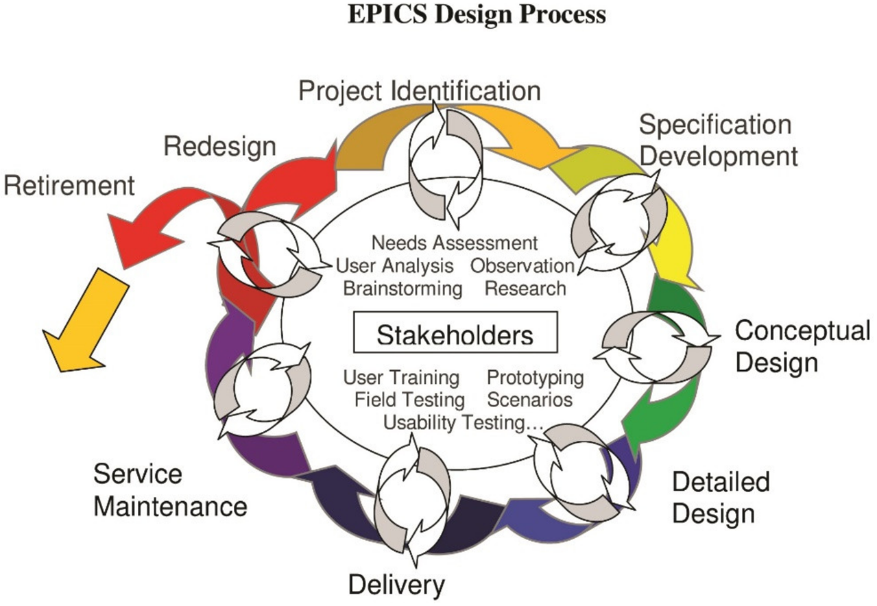
1) Streamlining – EPICS. The Projects should confine to societal problems with innovative solutions and reach targeted users
EPICS Design Process
Identifying a need
Establish design criteria and constraints
Evaluate alternative designs
Build a prototype of best design
Test and evaluate the prototype using the design criteria
Analyze test results, make design changes, and retest, if necessary
Communicate the design
29th IQAC meeting, 4th April 2023. V R Siddhartha Engineering College
Streamlining - EPICS

Slide 12
1) Streamlining – EPICS. The Projects should confine to societal problems with innovative solutions and reach targeted users
Suggestions for improvement
Directing the students & guides to strictly follow EPICS design Process
Conducting brainstorming sessions on EPICS to students & faculty
Appointing separate EPICS Committee at department level for meticulous examination on the progress of the project at every assessment.
Promoting the students to reach their innovations to the targeted community.
Promoting the students to exhibit their Innovations on prominent platforms.
Selection of the best EPICS project at department level…..and appreciation to students & faculty
Selection of the best EPICS project out of the best projects of departments at Institute level and appreciation to students & faculty.
29th IQAC meeting, 4th April 2023. V R Siddhartha Engineering College
Streamlining - EPICS

Slide 13
1) Streamlining – EPICS. The Projects should confine to societal problems with innovative solutions and reach targeted users
Institution’s EPICS Projects - Samples:
Dept | EPICS Projects - samples
CSE | Diabetic analyser Unit – Design patent -Granted
 | Smart Driver Monitoring System – Patent Published
 | Real time Weather Forecast model for Disaster Management using Machine Learning Algorithms.
 | Smart door lock using simultaneous face liveliness & face detection
 | PAW Patrol – IoT based smart wearable device for woman (Paedophile / Alzheimer woman)
IT | Smart remote health monitoring system.
 | IoT based vehicle accident detection and rescue system
 | Smart blind stick using ESP-32s with voice alert
 | Automatic Alcohol sensing and Vehicle Accident detection using GPS and GSM
29th IQAC meeting, 4th April 2023. V R Siddhartha Engineering College
Streamlining - EPICS

Slide 14
B. Issues open for discussion
1) Streamlining – EPICS. The Projects should confine to societal problems with innovative solutions and reach targeted users
Institution’s EPICS Projects - Samples:
Dept | EPICS Projects - samples
EIE | Smart vision Goggles for Visually Impaired persons
ECE | Smart Electronics glove for disabled people
ECE | Design and Development of a writing machine for specially abled students to help them in their examinations
EIE | An Integrated Wireless Aquaculture Monitoring and Feed Management System
CE | Digitization in Civil Engineering
ME | Automatic Seat Belt Mechanism For Automobiles
29th IQAC meeting, 4th April 2023. V R Siddhartha Engineering College
Streamlining - EPICS

Slide 15
1) Streamlining – EPICS. The Projects should confine to societal problems with innovative solutions and reach targeted users
EPICS - Need of the hour:
The final outcome should reach the targeted users (file evidences).
Telecast the selected best project in intended regional media channels - Every dept. at least one per year
Telecast the selected best project among the depts. in National Channel / Channels, at least one at Institute level per year.
Technical Publications through papers / Patents
Exhibition / Presentation of EPICS - Projects on Prominent platforms – IITs / NITs / Govt Organisations / etc.
It also helps for Perception (NIRF) of the Institution.
29th IQAC meeting, 4th April 2023. V R Siddhartha Engineering College
Streamlining - EPICS

Slide 16
B. Issues open for discussion
Industry / Institute (IITs/NITs) collaborative joint venture projects in all departments.
Benefits
Another source of research grant from outside organizations, in the event of difficulty in getting sponsored research grants
Obviously, they are additional source of research grants, besides sponsored projects
Relations through collaborative projects with Institutions of repute (IITs/NITs), certainly help our Departments & Institute to grow better in all dimensions.
Hence the Heads of departments, those who are not having, are requested to focus seriously on Collaborative projects.
29th IQAC meeting, 4th April 2023. V R Siddhartha Engineering College
Institute Collaborative joint venture projects

Slide 17
Industry / Institute (IITs/NITs) collaborative joint venture projects in all departments.
Ways of getting Collaborative joint venture projects
Building relations with nearby NITs / IITs through…………..
Inviting experts from IITs/ NITs for training programs (summer schools, etc.),
Exchange programs for UG, PG students and faculty,
organizing the conferences, workshops and FDPs in collaboration with IITs/NITs,
Centers of Excellence in collaboration with IITs/ NITs,
Functioning MoUs, etc.
Taking the above events as an opportunity to fulfill our requirement.
29th IQAC meeting, 4th April 2023. V R Siddhartha Engineering College
Institute Collaborative joint venture projects

Slide 18
B. Issues open for discussion
Industry / Institute (IITs/NITs) collaborative joint venture projects in all departments.
Dept. | Project | Collaboration with | Grant | Duration | Status
CSE | Updating of very Large Scale Urban GIS maps with latest very high resolution satellite data using deep learning techniques | ISRO | 17,84,920 | 2 years | Ongoing
 | Qualitative and quantitative classification of mixed bamboo forests using geospatial technology | ISRO | 25,30,000 | 3 Years | Ongoing
29th IQAC meeting, 4th April 2023. V R Siddhartha Engineering College
Institute Collaborative joint venture projects

Slide 19
B. Issues open for discussion
Industry / Institute (IITs/NITs) collaborative joint venture projects in all departments.
Dept. | Project Title | Collaboration with | Grant | Duration | Status
IT | Developing Efficient Local Scale Impact Evaluation tools using Geospatial System to Assess National Development Mission Outcomes and SDG Goals | National Remote Sensing Centre (NRSC-ISRO) | 27,93,520 | 03 Years | Ongoing
 | Development and evaluation of algorithms for automated tree delineation and tree parameters (height and crown diameter) estimation for forestry applications | NRSC | 16,90,000 | 02 Years | Completed
 | Asset Mapping at Panchayat Level using Bhuvan-Panchayat Mobile Application | NRSC | 9,24,000 | 8 Months | Completed
29th IQAC meeting, 4th April 2023. V R Siddhartha Engineering College
Institute Collaborative joint venture projects

Slide 20
B. Issues open for discussion
Industry / Institute (IITs/NITs) collaborative joint venture projects in all departments.
Dept. | Project | Collaboration with | Grant | Duration | Status
ECE | FPGA based Voter Algorithm using VHDL for fail safe Systems | Efftronics systems pvt Ltd | 2.95 Lakhs | 6 months | Completed
 | FPGA. ARM/Bluetooth, Zigbee, NFC /AI/ML protocols | Efftronics systems pvt Ltd | 8 Lakhs | 3 months | Completed
 | Fabrication and performance analysis of Ventilation Assistant | Avantel Ltd | 10.5 Lakhs | 1 Year | Ongoing
29th IQAC meeting, 4th April 2023. V R Siddhartha Engineering College
Institute Collaborative joint venture projects

Slide 21
B. Issues open for discussion
3) Refresher Training program on OBE
Proposed with an intention of updating skills and knowledge to a changed standard and further refinement in OBE practice in the Institution
The IT department took the charge to organize the program
Topic: Implementation of Outcome Based Education
Focusing on Higher order knowledge levels,
Defining appropriate COs in new programs &
Setting higher PO attainment targets in existing programs).
Resource Persons: NITTTR, Chennai
Tentative Schedule of the program: May/June 2023
29th IQAC meeting, 4th April 2023. V R Siddhartha Engineering College
Refresher training program on OBE

Slide 22
Any other item with the permission of Chairman
29th IQAC meeting, 4th April 2023. V R Siddhartha Engineering College
Any other item
Any other item

Slide 23
29th IQAC meeting, 4th April 2023. V R Siddhartha Engineering College
Thank you

