Slide 1


WELCOME
2nd IQAC Meeting
Wednesday, 05th March 2025

Slide 2

Agenda
Action taken report on the proposals of 1st IQAC meeting
Strengthening outreach programs for community development through national schemes
Advancing Industry-Institute relation through translational research
Open for discussion
Adoption of NAAC accreditation criteria for transitioning from Autonomous Institute to Deemed-to-be University status.
Enhancing Teaching-Learning Methods in alignment with Pedagogical Innovations of NEP-2020
Any other item with permission of chairperson

Slide 3
Action taken report on the proposals of
1st IQAC meeting
Strengthening outreach programs for community development through national schemes
Objective of Strengthening outreach programs
  To address Social, Economic and Environmental problems
  To bring Academics and Communities closer
  To increase the Institution's Role in helping Society

Slide 4
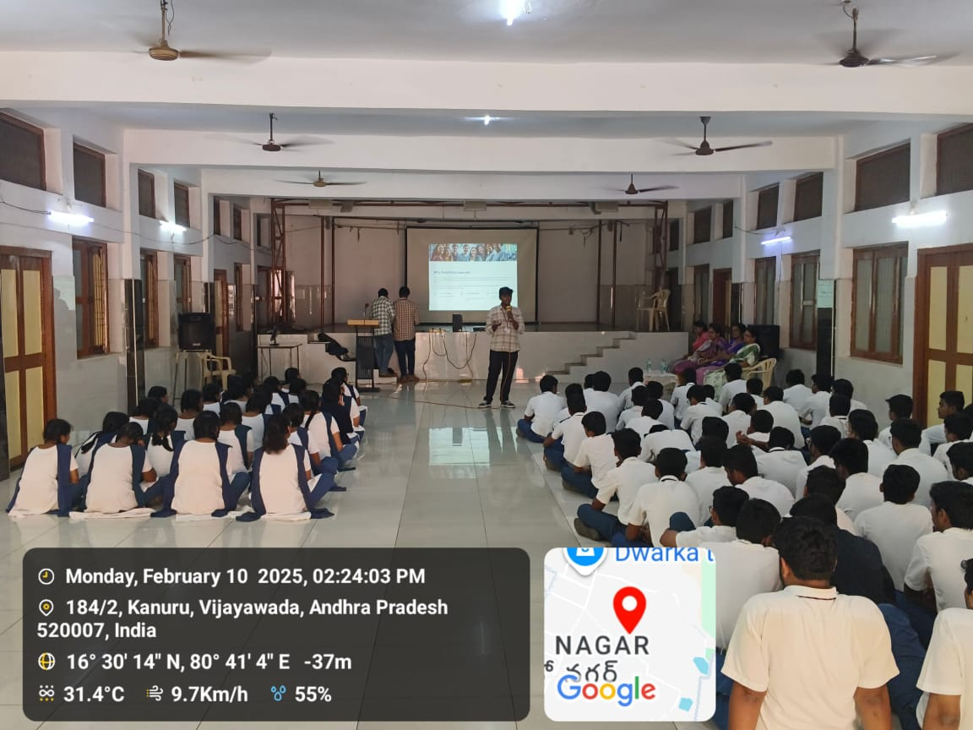
Action taken report on the proposals of
1st IQAC meeting-Strengthening Outreach Programs
IT Department: AI Bootcamp for High Schoolers - Dive into the Future of Tech KCP Adarsh Siddhartha Public School-Kanuru

Slide 5
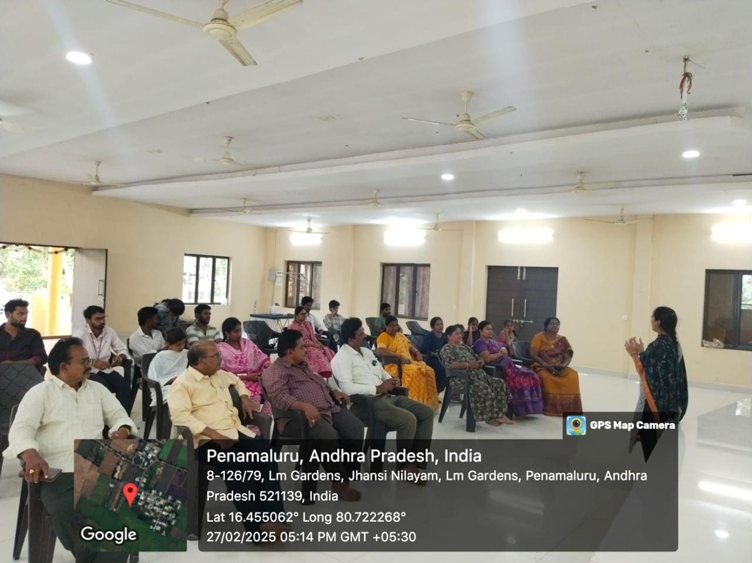
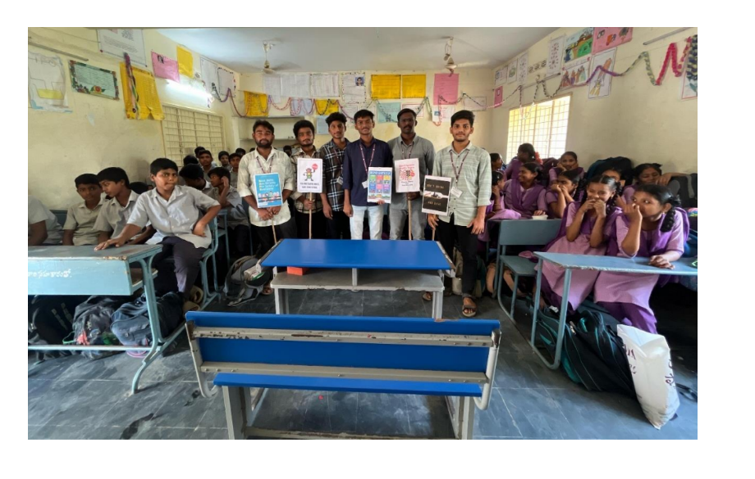
CE Department:
Awareness on Rainwater Harvesting @ STBL-LM Gardens- Penamaluru
Road Safety Awareness @ NH 65 near Kanuru
Traffic Awareness and Traffic Rules @ Z.P. High School, Poranki

Slide 6
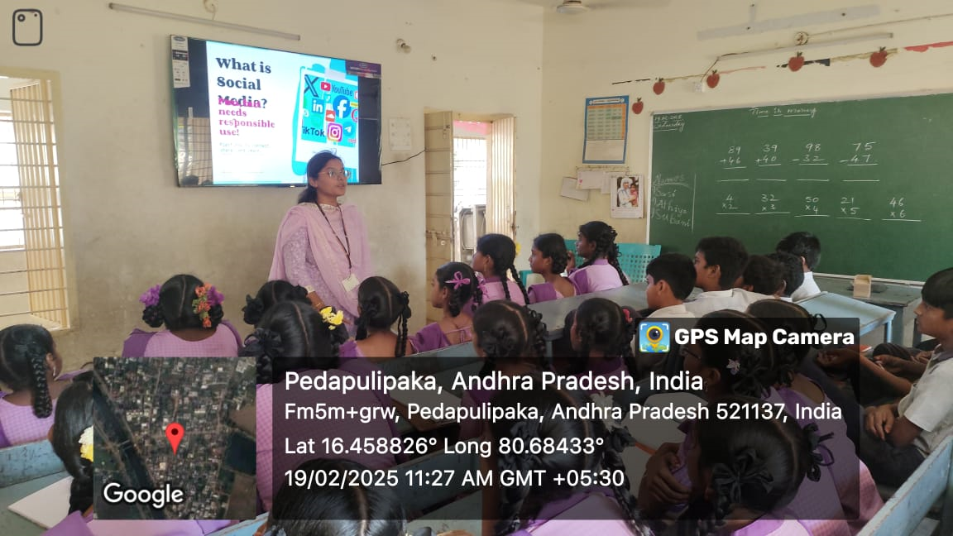
ECE Department: Safe Usage of Social Media
MPUP School - Pedapullipaka

Slide 7
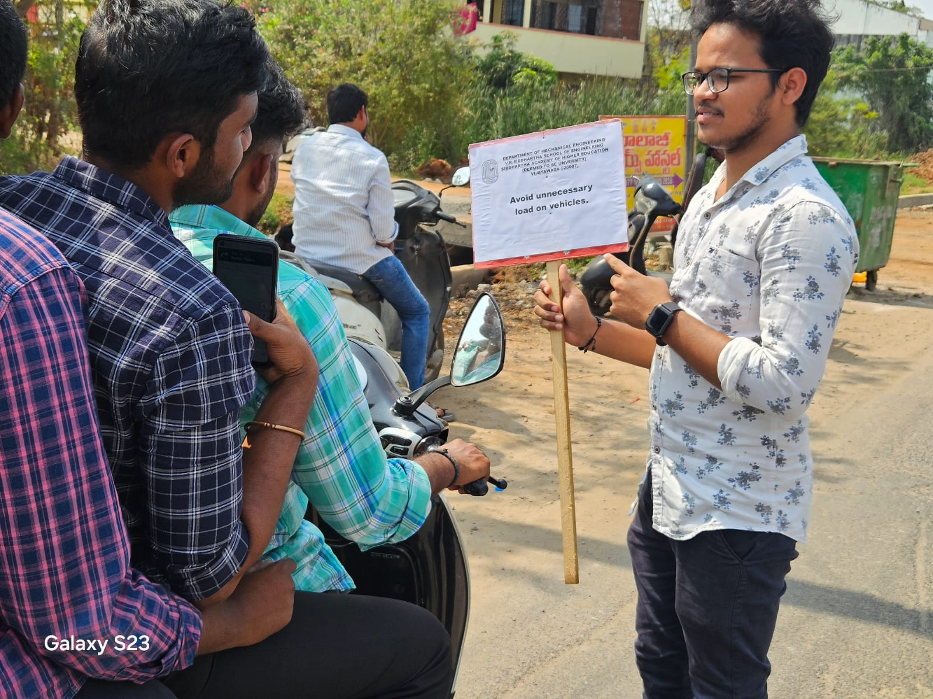
ME Department: Awareness on Fuel Effeciency
Kanuru, Poranki

Slide 8
MCA Department: Extension Activity - Tech Support for Schools- Awareness and Orientation session
Z.P. High School- Pedaravvuru-Tenali

Slide 9
Action taken report on the proposals of
1st IQAC meeting
Advancing industry-institute relation through translational research
1. CE Department: Dr. N.R.K. Murthy & Dr. Ch.R. Vara Prasad – Ground Improvement Design Report for Reinforced Soil Retaining Wall for construction of 4 lane ROB between Kaikaluru and Pallevada stations, Andhra Pradesh - M/S. Trenzet Infra Private Limited, Vijayawada. – Rs. 1,18,000/- (12.12.2024 to 06.02.2025) –
2. CE Department Dr. N.R.K. Murthy & Dr. Ch.R. Vara Prasad – Design of Ground Improvement for Construction of Reinforced Earthen Wall proposed or Construction of Road over Bridge (ROB) at Gudivada, Andhra Pradesh – M/s Vallabhaneni Constructions Private Ltd, Vijayawada – Rs. 4,13,000/- (11.01.2025 – 12.02.2025)
3. EIE Department Dr.P Srinivas- Development, Operation & Generation of reports in the supply of water to villages from the water treatment plant through PLC SCADA & Wireless devices-Prototype - M/s Microsys Automation, Hyderabad -Rs.200000 (02.11.2024 to 01.11.2026)
4. EIE Department Mr. V N Prudhvi Raj, Development of handheld portable ultrasound system- M/s Microsys Automation Pvt. Ltd., Hyderabad. Rs.2,00,000/-. (02-11-2024 to 02-11-2026)

Slide 10



Issues open for Discussion
Adoption of NAAC accreditation criteria for transitioning from Autonomous Institute to Deemed-to-be University status.
Enhancing Teaching-Learning Methods Aligned with Pedagogical Innovations of NEP-2020
Any other with permission of chairperson.

Slide 11
NAAC accreditation criteria for transitioning from Autonomous Institute to Deemed-to-be University status.

Slide 12
Weightages for seven criteria for Universities and Autonomous Colleges
Criteria | Universities | Autonomous Colleges
1. Curricular Aspects | 150 | 150
2. Teaching-Learning and Evaluation | 200 | 300
3. Research, Innovations, and Extension | 250 | 150
4. Infrastructure and Learning Resources | 100 | 100
5. Student Support and Progression | 100 | 100
6. Governance, Leadership, and Management | 100 | 100
7. Institutional Values and Best Practices | 100 | 100
Total Weightage | 1000 | 1000

Slide 13
Key Areas to Improve

Slide 14
1. Teaching-Learning and Evaluation (200 Marks)
Sub-Criterion | Strategies for Higher Scores
Student Enrolment Profile | Improve diversity, admit meritorious students, provide scholarships.
Innovative Teaching Methods | Implement ICT-based teaching, flipped classrooms, virtual labs, and AI-driven adaptive learning.
Experiential Learning | Increase internships, industry projects, fieldwork, and hands-on training.
Faculty Quality & Development | Encourage faculty certifications (MOOCs, AICTE/UGC-approved FDPs), promote PhD-qualified faculty, and support international collaborations.
Student Performance & Learning Outcomes | Conduct regular assessments, feedback mechanisms, peer learning, and continuous internal evaluation (CIE).
Use of Learning Management Systems (LMS) | Implement Moodle, Google Classroom, or custom university portals to track student engagement and progress.
Outcome-Based Education (OBE) Implementation | Ensure strong mapping of Course Outcomes (COs) → Program Outcomes (POs) → Program Educational Objectives (PEOs).
Examination Reforms | Move towards AI-based proctoring, automation in result processing, and flexible evaluation policies.

Slide 15
2. Research, Innovations & Extension (250 Marks)
Sub-Criterion | Strategies for Higher Scores
Research Publications | Increase Scopus, Web of Science, and UGC-CARE indexed publications.
Citation & Impact Factor | Encourage high-impact factor journal publications with collaborative research groups.
Sponsored Research & Grants | Secure funding from DST, UGC, AICTE, DRDO, DBT, ICSSR, and international bodies.
Patents & Innovations | Establish IPR cells, technology incubation centers, and innovation hubs
Consultancy & Industry Collaboration | Partner with industries for funded projects, MoUs, and technology consultancy services.
Faculty & Student Research Incentives | Implement research grants, seed funding, and incentives for top-performing researchers.
Interdisciplinary & Multidisciplinary Research | Promote research integrating AI, IoT, healthcare, social sciences, and sustainability.
Extension & Outreach Activities | Encourage faculty and students to participate in community service.

Slide 16


General Recommendations for Higher Scores
Develop Research Centers – Create Centers of Excellence (CoEs) focusing on AI, Quantum Computing, Sustainability, and Cybersecurity.
2. Establish Strong Industry-Academia Ties – Collaborate with TCS, Infosys, Microsoft, IBM, and DRDO for research funding.
3. Encourage Student-Led Research – Support UG and PG students in publishing research in reputed journals.
4. Adopt Digital Tools – Use AI-based academic analytics tools to track student learning.
5. Improve Documentation – Maintain proper evidence of all research activities, publications, patents, and MoUs to present in NAAC evaluations.

Slide 17

Enhancing Teaching-Learning Methods Aligned with Pedagogical Innovations of NEP-2020

Slide 18
NEP-2020
National Education Policy (NEP) 2020: A paradigm shift in education.
Focus on holistic, multidisciplinary, and flexible learning.
Emphasis on competency-based education, critical thinking, and creativity.

Slide 19
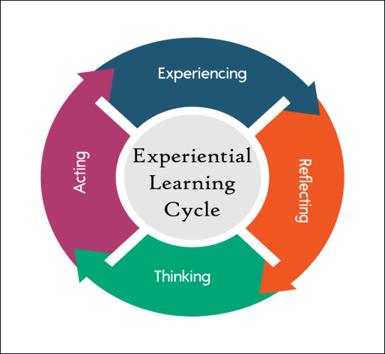
1. Experiential Learning
🔹 Method: Hands-on, real-world application-based learning.
🔹 Implementation:
Encourage lab-based experiments, case studies, and simulations.
Introduce fieldwork, industry internships, and research-based learning.
Develop community engagement projects (Unnat Bharat Abhiyan, Swachh Bharat projects, etc.).
Use role-playing and storytelling techniques for subjects like history and business studies.

Slide 20
2. Multidisciplinary & Holistic Learning
🔹 Method: Integration of multiple disciplines for a broad-based education.
🔹 Implementation:
Develop interdisciplinary courses combining Science, Arts, and Humanities.
Encourage collaborative projects across departments.
Implement Choice-Based Credit System (CBCS) for flexible learning paths.
Introduce value-based education (ethics, environmental studies, life skills).

Slide 21
3. Digital & Online Learning (EdTech Integration)
🔹 Method: Use of technology-driven teaching-learning tools.
🔹 Implementation:
Deploy Learning Management Systems (LMS) like Moodle, Google Classroom, SWAYAM.
Introduce AI-based adaptive learning platforms for personalized education.
Promote virtual labs, augmented reality (AR), and virtual reality (VR) simulations.
Facilitate remote learning through online certifications and MOOCs (SWAYAM, NPTEL, Coursera, edX, etc.).

Slide 22
4. Competency-Based & Outcome-Oriented Learning
🔹 Method: Focus on skill-based and competency-driven education.
🔹 Implementation:
Implement Outcome-Based Education (OBE) with clear Course Outcomes (COs) and Program Outcomes (POs).
Conduct project-based, inquiry-based, and problem-solving assignments.
Assess students using rubric-based evaluation and peer assessments.
Encourage skill-based internships and apprenticeships in industry settings

Slide 23
5. Personalized & Adaptive Learning
🔹 Method: Tailoring education to individual learning needs.
🔹 Implementation:
Utilize AI-driven analytics to track student progress and offer customized learning paths.
Implement self-paced learning modules with recorded lectures and quizzes.
Use gamification and interactive quizzes (Kahoot, Quizizz, etc.) to make learning engaging.
Introduce mentorship and peer-learning frameworks for student support.

Slide 24
6. Inquiry-Based & Research-Driven Learning
🔹 Method: Encouraging curiosity-driven exploration and innovation.
🔹 Implementation:
Promote undergraduate research projects and publishing opportunities.
Establish incubation centers and startup support for entrepreneurial learning.
Encourage design-thinking and innovation challenges (Hackathons, Smart India Hackathon, etc.).
Introduce Capstone projects and industry-driven problem-solving initiatives.

Slide 25
7. Flexible & Modular Learning Paths
🔹 Method: Providing students with multiple entry and exit options.
🔹 Implementation:
Introduce Multiple Entry-Exit System (MEES) as per NEP-2020.
Offer micro-credentials, diploma, degree stacking for progressive learning.
Enable inter-institutional credit transfer through Academic Bank of Credits (ABC).
Implement skill-certification programs linked to employability.

Slide 26
8. Peer Learning & Collaborative Learning
🔹 Method: Encouraging learning through group activities and teamwork.
🔹 Implementation:
Conduct flipped classroom sessions where students learn before class and discuss in groups.
Foster study circles, student-led seminars, and group discussions.
Promote cross-institutional collaborations for research and case studies.
Utilize discussion forums, online debate platforms, and collaborative tools (Miro, Padlet, etc.).

Slide 27
9. Vocational & Skill-Based Learning
🔹 Method: Focus on employability and real-world application.
🔹 Implementation:
Introduce domain-specific skill courses in collaboration with NSDC and industry.
Promote industry certification programs in IT, healthcare, AI, blockchain, cybersecurity, etc.
Integrate internships and on-the-job training as part of the curriculum.
Encourage entrepreneurial education with startup incubation support.

Slide 28
10. Continuous & Holistic Assessment Methods
🔹 Method: Moving beyond traditional exams towards diverse evaluation techniques.
🔹 Implementation:
Introduce open-book exams, case-based assessments, and portfolio evaluations.
Use 360-degree feedback from peers, faculty, and industry mentors.
Implement Competency-Based Assessment (CBA) and formative evaluations.
Leverage automated digital grading tools for efficiency.

Slide 29
Conclusion
Transforming Teaching-Learning with NEP-2020
The adoption of innovative, flexible, and technology-driven teaching methods will enhance learning outcomes.
A student-centric, experiential, and research-based approach will ensure skill development and employability.
Universities and colleges should integrate these pedagogical innovations to achieve higher NAAC accreditation and academic excellence.

Slide 30


Slide 31


