Slide 1
WELCOME
30th IQAC Regular Meeting
Wednesday, 28th June 2023
30th IQAC meeting, 28th June 2023. V R Siddhartha Engineering College
WELCOME

Slide 2
Agenda
A) Action taken report on the proposals of 29th IQAC meeting
EPICS. The projects should confine to societal problems with innovative solutions and reach targeted users.
Industry / Institute (IITs / NITs) Collaborative joint venture projects. Their execution in all departments.
Refresher Training program on OBE (Focusing on higher order knowledge levels, defining appropriate COs & setting higher PO attainment levels).
B) Issues open for discussion
Attention on improving Granting of Patents in proportion to publishing.
2) Implementation of Academic Bank of Credits.
3) Any other item with the permission of Chairperson.
30th IQAC meeting, 28th June 2023. V R Siddhartha Engineering College
Agenda

Slide 3
A) Action taken report on the proposals of 29th IQAC meeting
1) EPICS. The projects should confine to societal problems with innovative solutions and reach targeted users.
Suggested the following for improvement
Directing the students & guides to strictly follow EPICS design Process
Conducting brainstorming sessions on EPICS to students & faculty
Appointing separate EPICS Committee at department level for meticulous examination on the progress of the project at every assessment level.
Promoting the students to reach their innovations to the targeted community.
Promoting the students to exhibit their Innovations on prominent platforms.
30th IQAC meeting, 28th June 2023. V R Siddhartha Engineering College
EPICS

Slide 4
1) EPICS. The projects should confine to societal problems with innovative solutions and reach targeted users.
EPICS – Recommended to implement
Selection of the best EPICS project at department level…..and appreciation to students & faculty
Selection of the best EPICS project at Institute level out of the best projects of departments and appreciation to students & faculty.
Telecast the selected the best project in intended regional media channels - Every dept. at least one per year.
Telecast the selected the best project among the depts. in National Channels, one at Institute level per year.
Technical Publications through papers / Patents
Exhibition / Presentation of EPICS - Projects on Prominent platforms – IITs / NITs / Govt. Organisations / etc.
30th IQAC meeting, 28th June 2023. V R Siddhartha Engineering College
EPICS

Slide 5
1) EPICS. The projects should confine to societal problems with innovative solutions and reach targeted users.
Innovative EPICS Projects selected by departments in 2022-23
Dept | Title of the Project
CSE | Battery Monitoring System in Electric Vehicles for the User's Safety Smart Rain Protection cover using IoT Smart Reader for visually impaired An AI based mental health support Chabot for Cyber bullied Victims
ME | Development of Safety Helmet using Rice Straw/ Bagasse hybrid composite material Smart Trash Bin
EEE | Child rescue system from open bore wells using Robotic Module. Design and Implementation of smart electric two-wheeler considering real-time operating conditions.
Note: EPICS projects should useful to community (People/schools/local governments),but not for profit organizations.
30th IQAC meeting,28th June 2023. V R Siddhartha Engineering College
EPICS

Slide 6
1) EPICS. The projects should confine to societal problems with innovative solutions and reach targeted users.
Innovative EPICS Projects selected by departments in 2022-23
Dept | Title of the Project
IT | Cataract detection using Mobile Application Change detection Algorithm for Vegetation Mapping using Multispectral Image Processing
ECE | AI Powered Continuous Glucose Monitoring and Controlling System: Pumping Module and Sensing Module
EIE | An Integrated Wireless Aquaculture Monitoring and Feed Management System Design and development of 6-axis robotic arm for industrial applications
CE | Identification of Accidents using Sensors Traffic Management at Level Crossing Development of mitigation strategies for sustainable development of coastal zone
30th IQAC meeting,28th June 2023. V R Siddhartha Engineering College
EPICS

Slide 7
A) Action taken report on the proposals of 29th IQAC meeting
2) Industry / Institute (IITs / NITs) collaborative joint venture projects. Their execution in all depts.
Recommended to implement
Building relations with nearby NITs / IITs through…………..
Inviting experts from IITs/ NITs for training programs (summer schools, etc.),
Exchange programs for UG, PG students and faculty,
organizing the conferences, workshops and FDPs in collaboration with IITs/NITs,
Centers of Excellence in collaboration with IITs/ NITs,
MoUs / Linkages with such Institutions, etc.
Taking the above events as an opportunity to fulfill our requirement.
30th IQAC meeting, 28th June 2023. V R Siddhartha Engineering College
Institute Collaborative joint venture projects

Slide 8
A) Action taken report on the proposals of 29th IQAC meeting
2) Industry / Institute (IITs / NITs) collaborative joint venture projects. Their execution in all depts.
Action taken by the departments
Dept. | Action taken
CSE | ISRO, Rs.43,14,920
IT | NRSC-ISRO, Rs.54,07,520
ECE | Efftronics & Aventel-Rs.21.50 Lakhs (11+10.5)
CE | MoU…..CSIR National Institute of Oceanography (NIO), Dona Paula, Goa
EIE | MoU…..Microgrid Technologies, Visakhapatnam
EEE | ---
ME | ---
Directed the departments to continue the process for getting Joint Venture Projects
30th IQAC meeting, 28th June 2023. V R Siddhartha Engineering College
Institute Collaborative joint venture projects

Slide 9
A) Action taken report on the proposal of 29th IQAC meeting
3) Refresher Training program on OBE (Focusing on Higher order knowledge levels, defining
appropriate COs & setting higher PO attainment targets).
Proposed with an intention of updating skills and knowledge to a changed standard and further refinement in OBE practice in the Institution
The IT department took the charge to organize the program
Topic: Outcome Based Education
Focusing on Higher order knowledge levels,
Defining appropriate COs in new courses &
Setting higher PO attainment levels in existing programs.
Resource Persons: NITTTR, Chennai
Tentative Schedule of the program: July 2023
30th IQAC meeting, 28th June 2023. V R Siddhartha Engineering College
Refresher Training program on OBE

Slide 10
Agenda
B) Issues open for discussion in 30th meeting
1) Attention on improving Granting of Patents in proportion to publishing.
2) Implementation of Academic Bank of Credits.
3) Any other item with the permission of Chairperson.
30th IQAC meeting, 28th June 2023. V R Siddhartha Engineering College
Agenda

Slide 11
B) Issues open for discussion
1) Attention on improving ‘Granting of Patents’ then commercialization
PATENTS:
Indian Utility patents
International Patents / PCT
Indian Design patents
Copy Rights
Granting
Hearing
Reply to FER
Hearing – not compulsory
Request for Exam
FER
Publishing
Filing
Note: Only Utility patents are considered for analysis.
Note: NIRF is not considering Design Patents & Copy rights
30th IQAC meeting, 28th June 2023. V R Siddhartha Engineering College
Granting of Patents

Slide 12
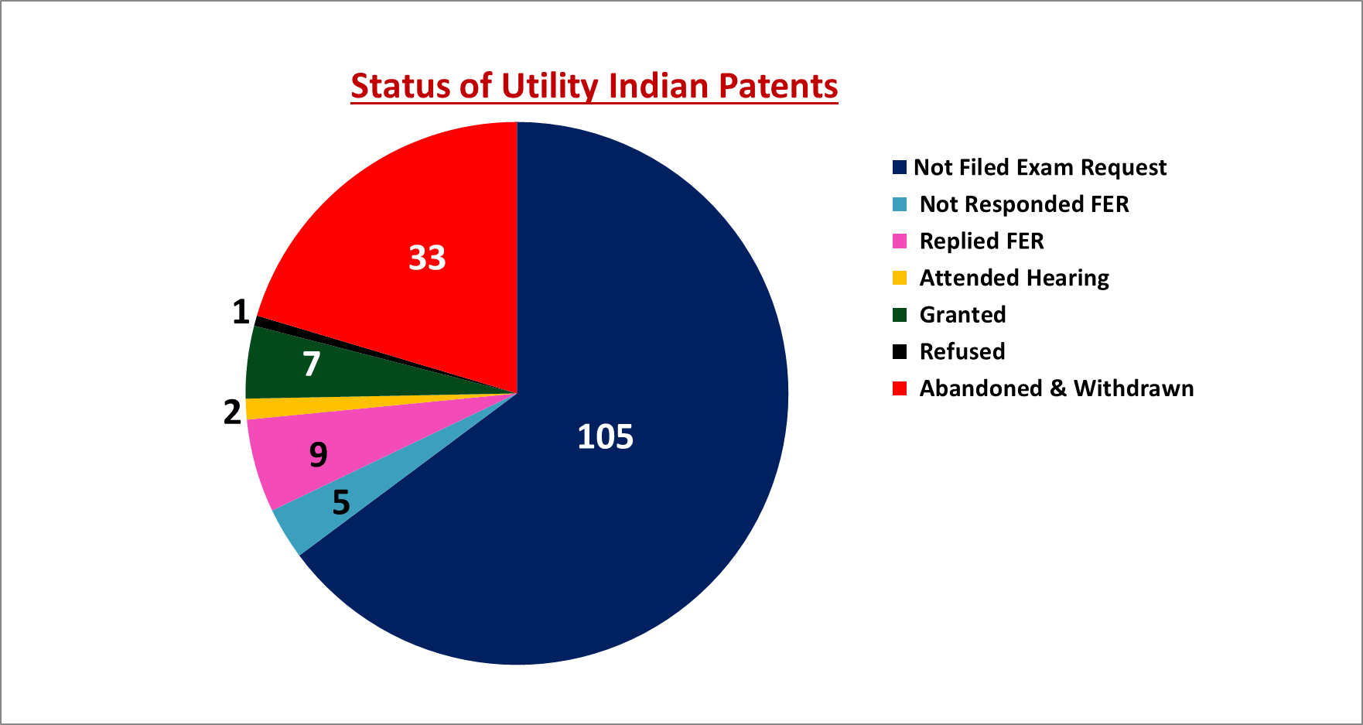
B) Issues open for discussion
1) Attention on improving ‘Granting of Patents’ then commercialization
Most contributed depts are CSE & IT
No granting of patents from ME & EEE in Engineering;
MBA, MCA, Maths, Physics, Chemistry & Eng in non-engineering depts.
Granted: Published = 7 : 162 => 1 : 23 or
% of granting = 4.3%
Weightage in NIRF:
Published : Granting = 25:75
No patent commercialised so far.
Total Utility patents: 162
The ultimate aim of patent filing is Granting & Commercialization
Note: NIRF is not considering Design Patents & Copy rights
30th IQAC meeting, 28th June 2023. V R Siddhartha Engineering College
Granting of Patents

Slide 13
1) Attention on improving ‘Granting of Patents’ then commercialization
Dept | Not Filed |  | Replied FER | Attended Hearing | Granted | Refused | Abandoned & Withdrawn
 | Exam Request | FER
CSE | 23 | 2 | 4 | 1 | 2 | 1 | 5+2
IT | 20 | 2 |  |  | 1 |  | 2
CSE&IT | 9 |  |  |  |  |  | 7
ECE | 11 |  | 1 |  | 1 |  | 4+1
EIE | 8 |  |  |  | 1 |  | 3+1
CE | 2 |  | 3 | 1 | 2
ME | 5 |  | 1 |  |  |  | 3+2
EEE | 6 | 1 |  |  |  |  | 2+1
MCA | 11
MBA | 3
Maths | 3
Phy | 1
Che | 3
Total | 105 | 5 | 9 | 2 | 7 | 1 | 26+7
No granting of patents in ME, EEE in Engineering;
MBA, MCA, Maths, Physics, Chemistry & Eng in non-engineering depts.
No patent commercialization so far.
Granted: Published = 7 : 162 => 1:23 or
% of granting = 4%
Weightage in NIRF: Published : Granting = 25:75
The ultimate aim of patent filing is Granting & Commercialization
Note: Data 2014-15 to till date; verified in official site https://ipindia.gov.in/ based on the data received from the depts
30th IQAC meeting, 28th June 2023. V R Siddhartha Engineering College
Granting of Patents

Slide 14
B) Issues open for discussion
1) Attention on improving ‘Granting of Patents’ then commercialization
Observations on personal interaction with Patent claimants
Most of the patents (32) published belongs to one person in CSE & IT
No / little interest in the faculty for follow up after publication for their FER
Difficulty / quality of work may be the reason for not facing FER & granting compared to publishing.
Several patents are as first / second / third claimants from outside Institutions.
Few faculty having Patents, left the Institution.
The ultimate aim of patent filing is Granting & Commercialization
30th IQAC meeting, 28th June 2023. V R Siddhartha Engineering College
Granting of Patents

Slide 15
B) Issues open for discussion
1) Attention on improving ‘Granting of Patents’ then commercialization
Status of utility patents after their publication
Recommendations
Not Requested For Exam : 105
Not filed Responses for FER : 5
Abandoned & withdrawn: 33
Refused after FER : 1
FER Replied & waiting for Result : 9
Hearing Completed & Waiting for Result : 2
Case to case review at dept level under the guidance of HoD at regular intervals.
Filing max patents by our faculty as first claimant.
Appointing patent expert / advisor for guidance to the claimants till the Granting / Commercialization.
Inviting suggestions from Heads & challenges facing by claimants, for improvement.
Monitoring of patents on regular basis in Depts.
30th IQAC meeting, 28th June 2023. V R Siddhartha Engineering College
Granting of Patents

Slide 16
B) Issues open for discussion
2) Academic Bank of Credits - Implementation
Academic Bank of Credit (ABC) – NEP 2020
“An Academic Bank of Credits (ABC) would digitally store the academic credits earned by students in various recognized HEIs so that the degrees from an HEI can be awarded taking into account credits earned”
AICTE has established the Academic Bank of Credits (ABC) portal on the lines of the National Academic Depository (NAD).
Academic Bank of Credits Platform
Academic Bank of Credits website: www.abc.gov.in.
HEIs & Students can open their ABC accounts
Account holders get a unique ID & access
Credits valid for seven years
used, or redeemed Credits earned by a student cannot be re-used
VRSEC ID – NAD041763
30th IQAC meeting, 28th June 2023. V R Siddhartha Engineering College
Academic Bank of Credits

Slide 17
B) Issues open for discussion
2) Academic Bank of Credits - implementation
Student Registration & Credit Transfer on ABC
1. Registration:
Student registers with their mobile number through Digi Locker.
A unique ABC ID is allotted
Institute ID can be shared to all the student enrolled
2. Login
Student logs in with an OTP from registered mobile number.
Student access ABC dashboard
Credits mapped to ABC ID are displayed on the Dashboard.
3. Transfer Initiation
Student selects credits of his / her choice
Initiates transfer by selecting the beneficiary Instt.
Provides additional details necessary for transfer
4. Credit Transfer Process
Academic Institution (AI) checks the eligibility of the transfer request based on the UGC Guidelines
The AI approves / rejects credit transfer request partially or fully based on the course structure
Provides reason for approval / rejection in the remarks column
5. Request Status
Student can check the request status
Gets notified of the credit transfer
All credit trails are maintained and reflected in student’s account
30th IQAC meeting, 28th June 2023. V R Siddhartha Engineering College
Academic Bank of Credits

Slide 18
B) Issues open for discussion
2) Academic Bank of Credits - implementation
APSCHE - Call for Action to HEIs and Timelines
Registration on ABC (www.abc.gov.in) …….26th June 2023
Formation of ABC Cell in HEI …..30th June 2023
Appoint ABC ‘Nodal Officer’ and share his Phone Number & Official email on institution’s website.
Create a hyperlink of www.abc.gov.in on your institution’s website.
Conduct of awareness programs to students and creating ABC ID for all Students……15th July 2023 for 2nd & 3rd Year students. Be an ongoing event for new batches of students.
Conduct of awareness programs to admitted students and creating ABC ID for all ……30th July.
Upload the mark sheets records with ABC ID for all the students who have appeared for the exams since 2021….30th Sept. 2023
30th IQAC meeting, 28th June 2023. V R Siddhartha Engineering College
Academic Bank of Credits

Slide 19
Any other item with the permission of Chairman
30th IQAC meeting, 28th June 2023. V R Siddhartha Engineering College
Any other item
Any other item

Slide 20
30th IQAC meeting, 28th June 2023. V R Siddhartha Engineering College
Thank you

