Slide 1
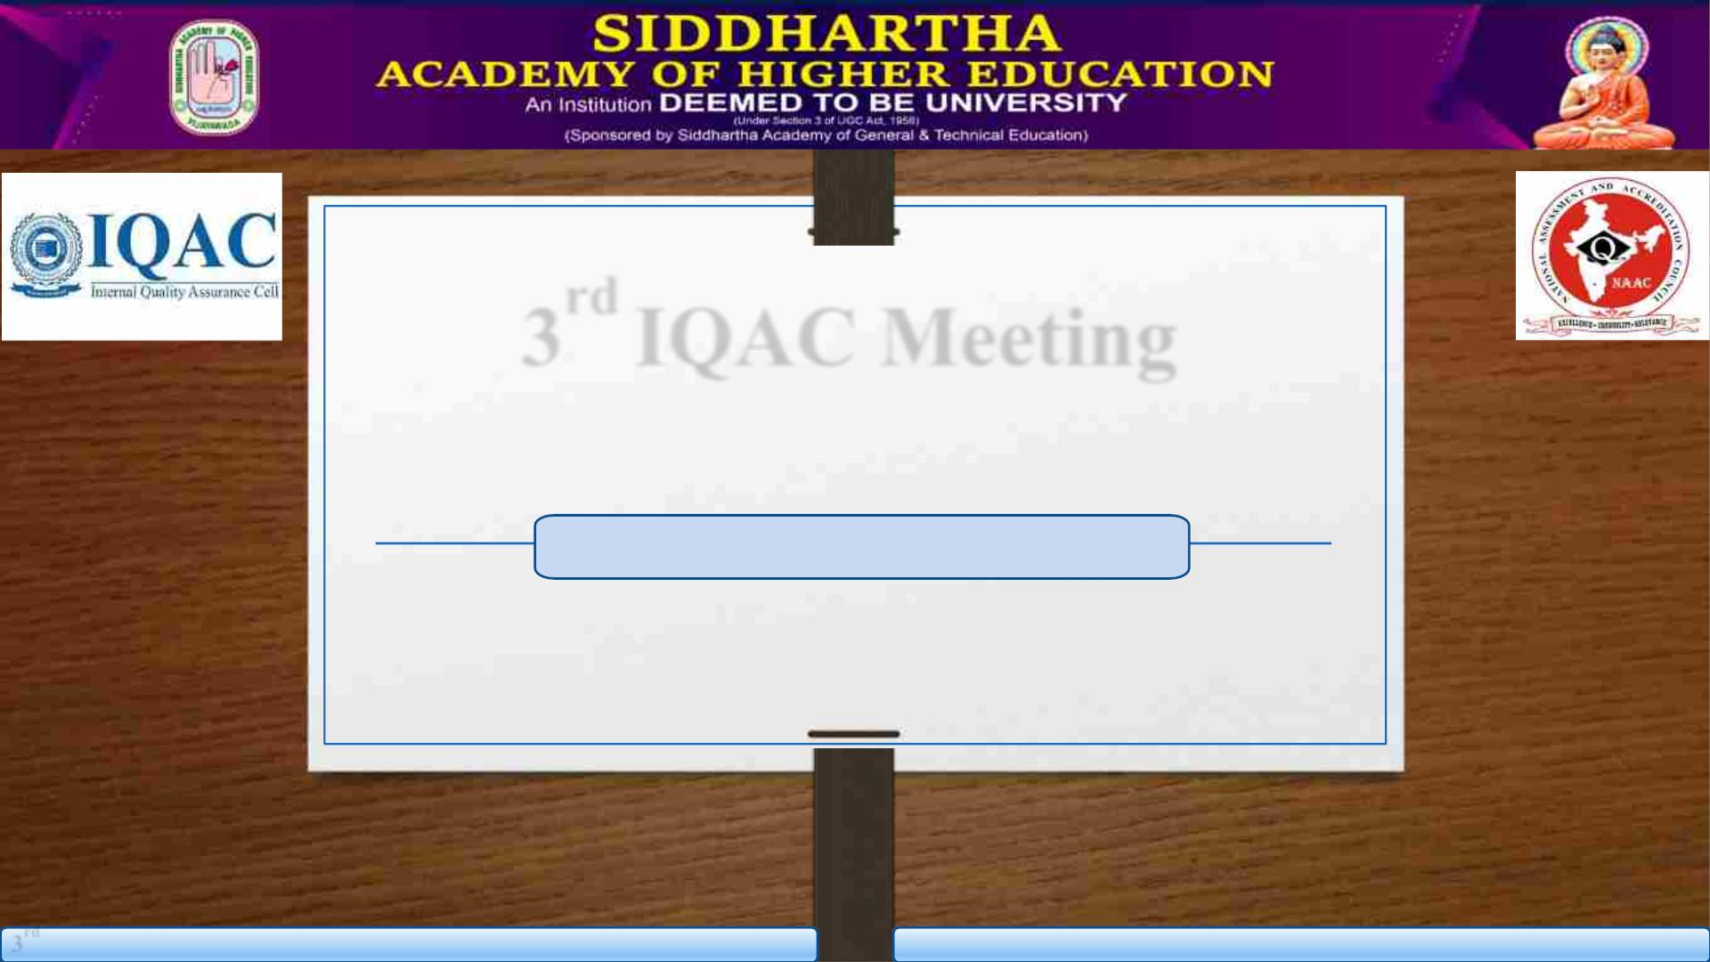
3rd IQAC Meeting
WELCOME
Saturday, 17th May 2025
3rd IQAC meeting, 17th May 2025. Siddhartha Academy Of Higher Education - SAHE
WELCOME

Slide 2
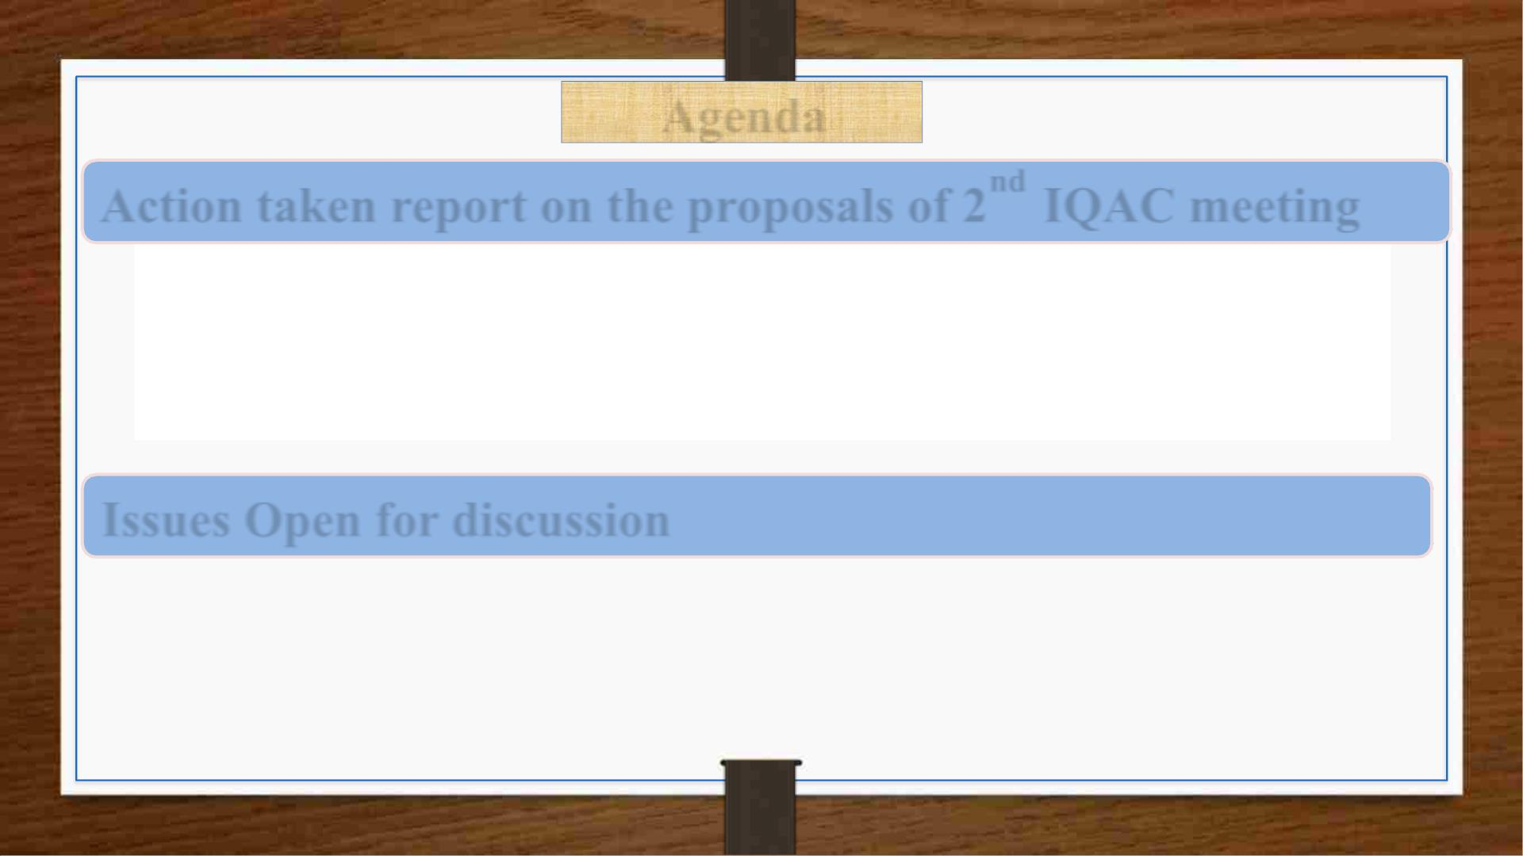
Agenda
Action taken report on the proposals of 2nd IQAC meeting
ü Adoption of NAAC accreditation criteria for transitioning from Autonomous
Institute to Deemed-to-be University status
ü Enhancing Teaching-Learning Methods in alignment with Pedagogical
Innovations of NEP-2020
Issues Open for discussion
ü Adoption of NEP 2020 aligned curriculum structure across all departments.
ü Review of student club activities and evaluate their impact on institutional
development and student welfare
ü Any other item with permission of chairperson

Slide 3
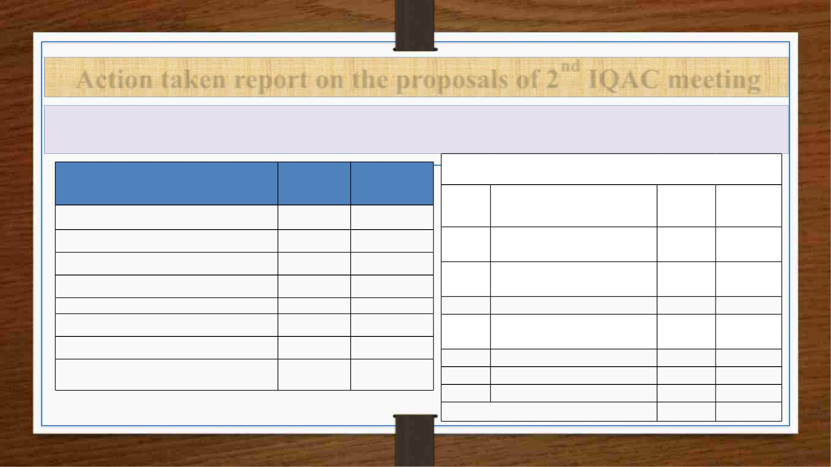
Action taken report on the proposals of 2nd IQAC meeting
1. NAAC accreditation criteria for transitioning from Autonomous Institute to Deemed-to-be
University status
Autonomous
Criterion III— Research, Innovations and Extension
Criteria
Universities
Colleges
Key
Indicator
University Autonomous
College
Metrics
1. Curricular Aspects
150
200
250
150
2. Teaching-Learning and Evaluation
3. Research, Innovations, and Extension
300
150
Promotion of Research and
3.1 Facilities
20
20
Resource Mobilization for
4. Infrastructure and Learning Resources
5. Student Support and Progression
100
100
100
100
100
100
3.2 Research
20
30
10
10
3.3
Innovation Ecosystem
6.Governance, Leadership and Management
Research Publications and
7. Institutional Values and Best Practices
Total Weightage
100
100
3.4 Awards
100
20
30
10
3.5
3.6
3.7
Consultancy
1000
1000
Extension Activities
Collaboration
40
50
20
20
Total Marks
250
150

Slide 4
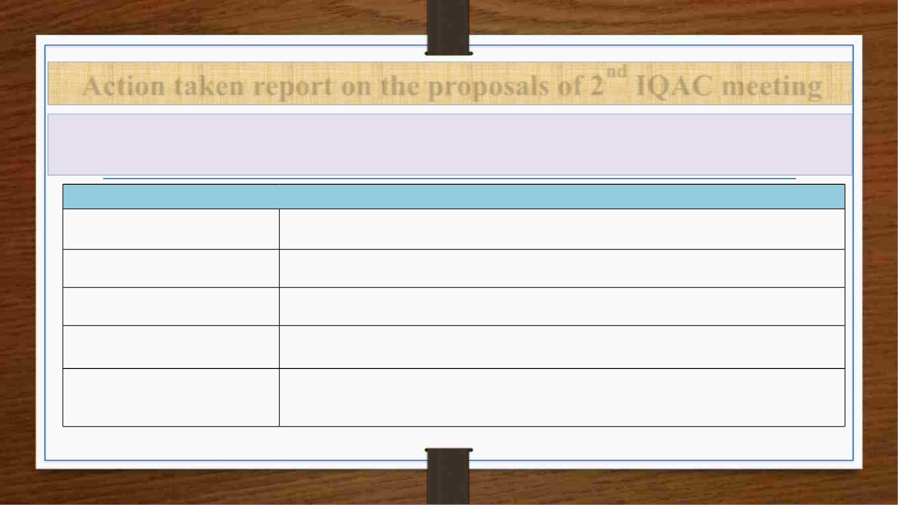
Action taken report on the proposals of 2nd IQAC meeting
1. NAAC accreditation criteria for transitioning from Autonomous Institute to
Deemed-to-be University status
Teaching-Learning and Evaluation (200 Marks)
Innovative Teaching Methods
ICT-based teaching, Flipped classrooms, Virtual labs, PhET , Quizizz –Padlet, Flowchart Maker ,Thing
link, Canva, Brisk Teaching,Napkin
Faculty Quality & Development
Experiential Learning
Encourage faculty certifications (e-Content development for MOOCs, AICTE/UGC-approved
FDPs),promote PhD-qualified faculty
Hands-on training on Virtual Labs, AI tools in Lesson plan, Literature survey, Review of research article,
Spoken Tutorial Project,Napkin, Crossword Labs , AI in Education
Student Performance & Learning
Outcomes
Conduct regular assessments, feedback mechanisms, peer learning, and continuous internal evaluation
(CIE) Rubistar ,Brisk Teaching,Assessment Techniques for Diversity ,AcadCal24
Use of Learning Management
Systems (LMS)
Implement Moodle, Google Classroom to track student engagement and progress Ekumbh (AICTE)
,Optimational Blog , connect. geant.org, OER Toolkit

Slide 5
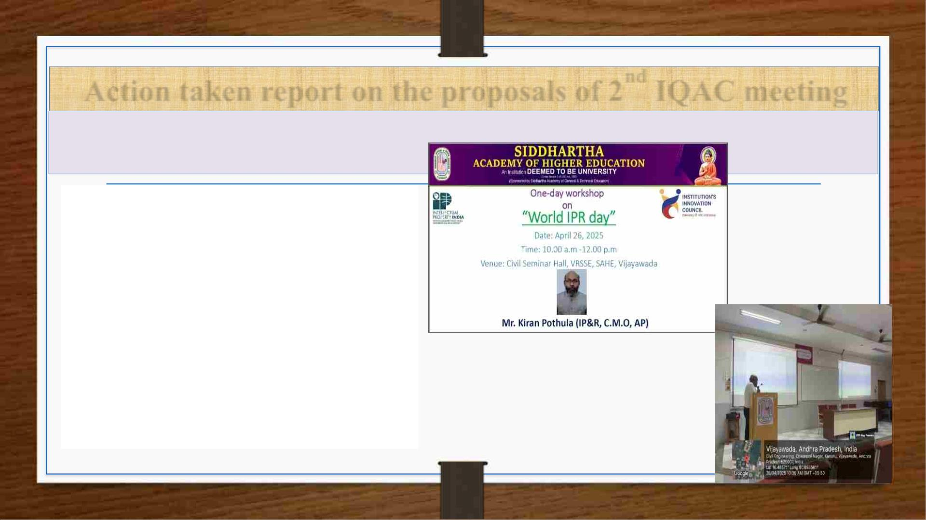
Action taken report on the proposals of 2nd IQAC meeting
1. NAAC accreditation criteria for transitioning from Autonomous Institute to
Deemed-to-be University status
Research, Innovations & Extension (250
Marks)
• Role of interdisciplinary research in
addressing complex global challenges.
• Establishing research incubation centers,
centers of excellence, and fostering academic-
industry collaborations.
• Faculty development programs to support
research
Organized one-day workshop on
“World IPR Day” on 26.04.2025
session delivered by Mr. Kiran
Pothula, IP&R section Chief Minister
office, Andhra Pradesh
• Creation of institutional frameworks to
promote research, collaboration, and the
adoption of best practices for innovation.

Slide 6
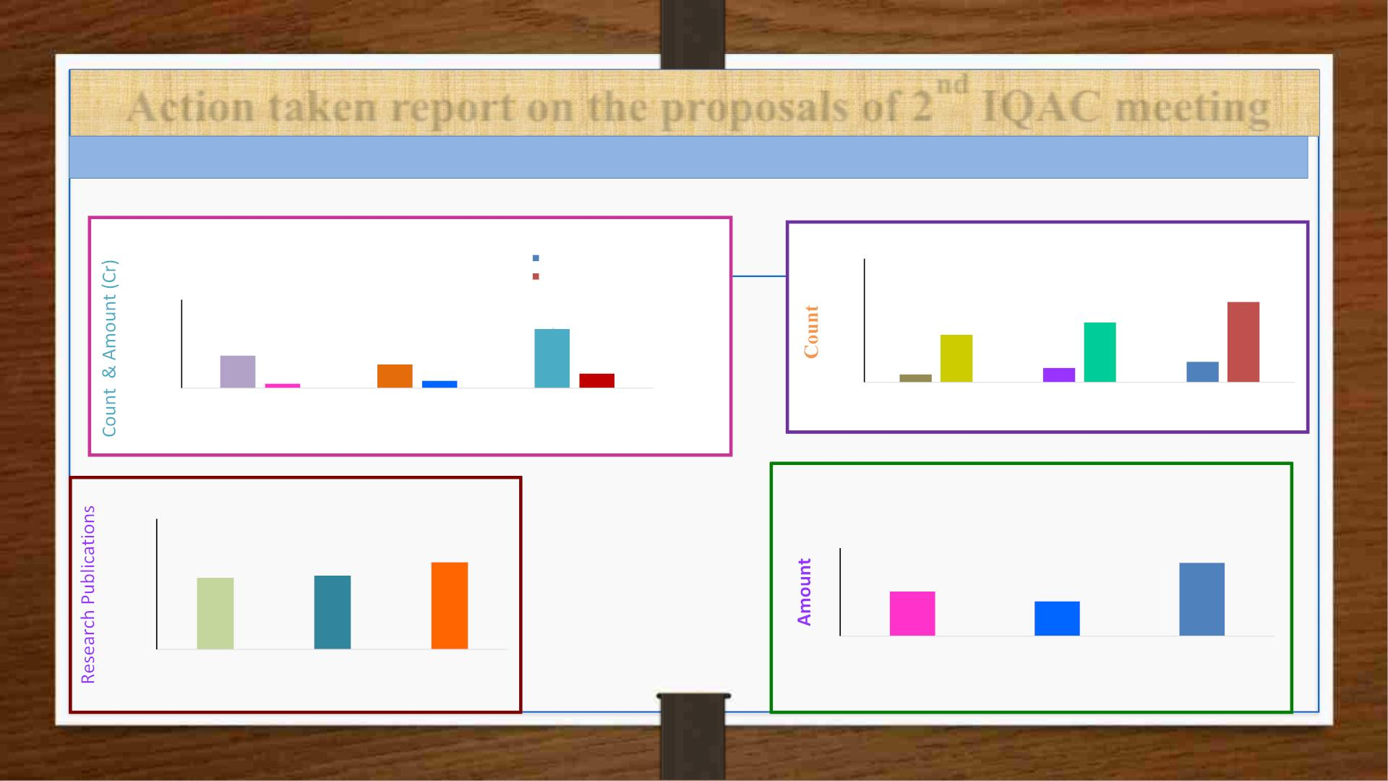
Action taken report on the proposals of 2nd IQAC meeting
1. NAAC accreditation criteria - Transitioning from Autonomous Institute to Deemed-to-be University status
Research, Innovations & Extension (250 Marks)
Number of projects received R&D Grants
Number of functional MoUs
No. of Projects
300
200
100
0
R&D Grant received in (Rs.Crores)
Target
20
Target 195
30
20
10
0
145
115
11
8
35
50
1.57
2.51
5
19
2023-24
2024-25
Academic Year
2025-26
2023-24
2024-25
Academic Year
2025-26
Research Publications
Revenue generated from consultancy in
(Rs.Crores)
Target 2.5
1500
1000
500
0
Targe
822
847
>1000
• R&D Grant
• Research
Publications
• Consultancy
• MoUs
3
2
1
0
1.52
1.19
2023-24
2024-25
Academic Year
2025-26
2023-24
2024-25
Academic Year
2025-26

Slide 7
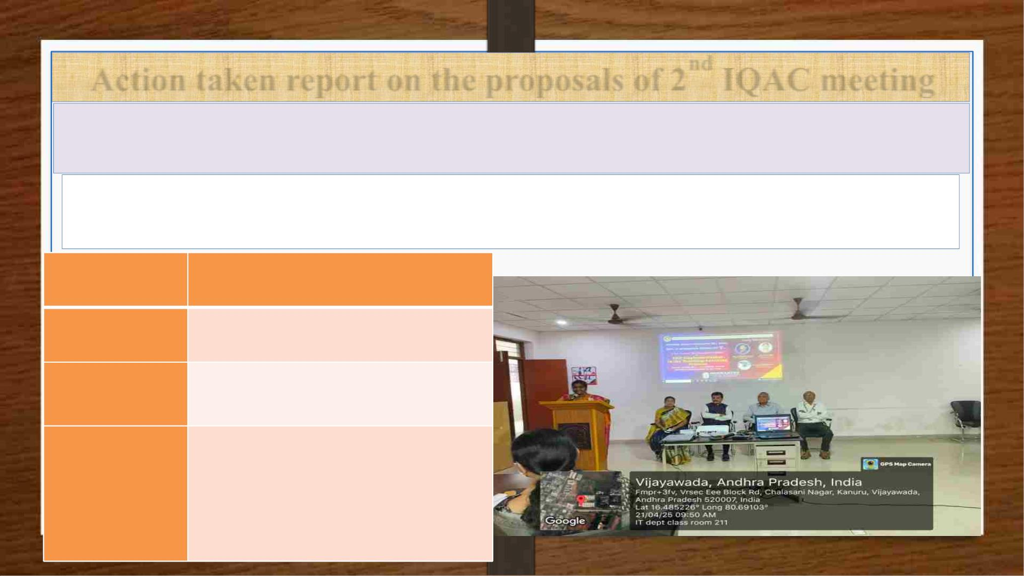
Action taken report on the proposals of 2nd IQAC meeting
2. Enhancing Teaching-Learning Methods Aligned with Pedagogical Innovations
of NEP-2020
Conducted 5-DAY Faculty Development Program on “NEP Implementation in
the Teaching-Learning Process"
Conducted
Dates
21-04-2025 to 25-04-2025
Inauguration of 5-Day FDP
No. of Faculty
attended
40
No. of Schools
Involved
5
• VR Siddhartha School of Engg
• School of Sciences
Name of the
Schools
• School of Law
• School of Management
• School of Arts & Commerce

Slide 8
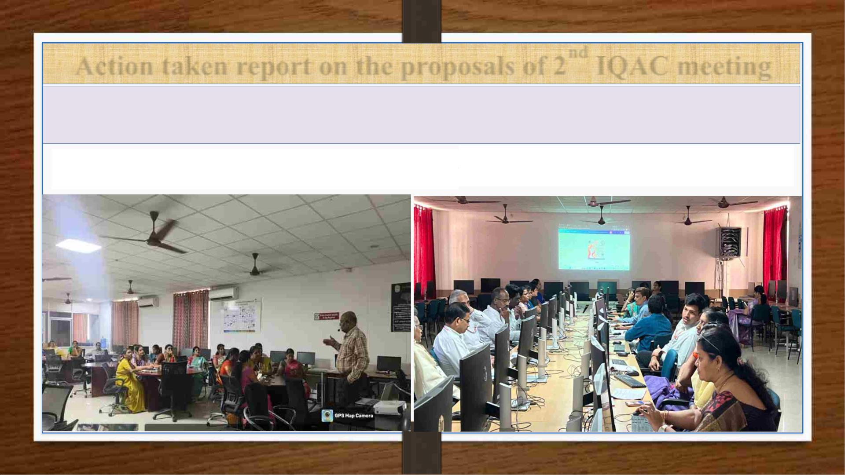
Action taken report on the proposals of 2nd IQAC meeting
Enhancing Teaching-Learning Methods Aligned with Pedagogical Innovations of
NEP-2020
Talk by Prof. Salman Abdul Moiz, Department of CSE,
Univ. of Hyderabad on Inclusivity, Ethics, and Global Perspectives
Hands on Training to Faculty in implementing
active learning methods

Slide 9
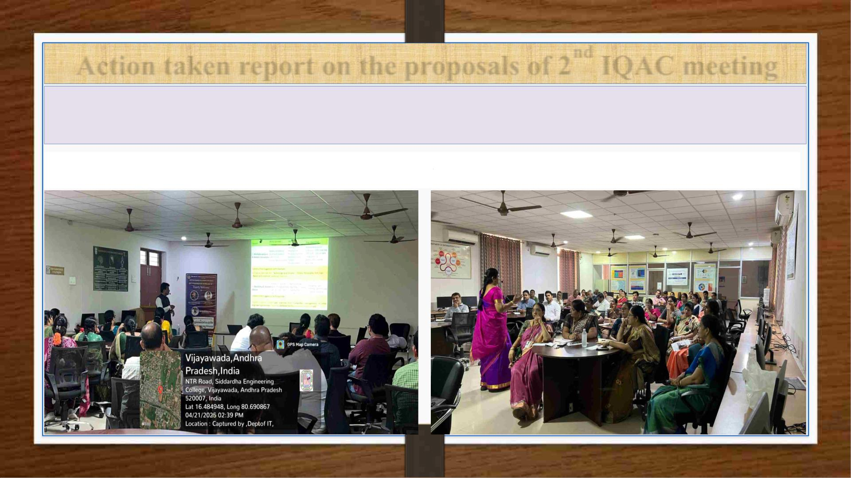
Action taken report on the proposals of 2nd IQAC meeting
Enhancing Teaching-Learning Methods Aligned with Pedagogical Innovations of
NEP-2020
Talk by Prof. S.Viswandha Raju ,Senior Professor of CSE, JNTUH on
Talk by Prof. P. Malliga, HOD of CSE at NITTTR, Chennai on
NEP 2020 – Transforming Higher Education
Pedagogical Innovations and Technology in Teaching

Slide 10

Issues open for Discussion
ü Adoption of NEP 2020 aligned curriculum structure across all
departments
ü Review of student club activities and evaluate their impact on
institutional development and student welfare
ü Any other with permission of chairperson.

Slide 11

Adoption of NEP 2020 aligned curriculum structure across
all departments

Slide 12

The National Education Policy (NEP)
Formulated by the Government of India to promote and regulate
education in India
• Transforming India’s Education Landscape
• Emphasis on Learning Outcomes
• Inclusivity and Equity
• Holistic development

Slide 13

Curriculum and Credit Framework for Undergraduate
Programmes (CCFUP)
As per the NEP 2020 recommendations, UGC developed a new curriculum and credit
framework for undergraduate programs in 2022 .
The framework reflects NEP recommendations :
• Restructured degree programs
• Multiple entry and exit
• Flexible degree options - Single major / Double major/ Interdisciplinary choices with
employability skills in addition to academic subjects.

Slide 14
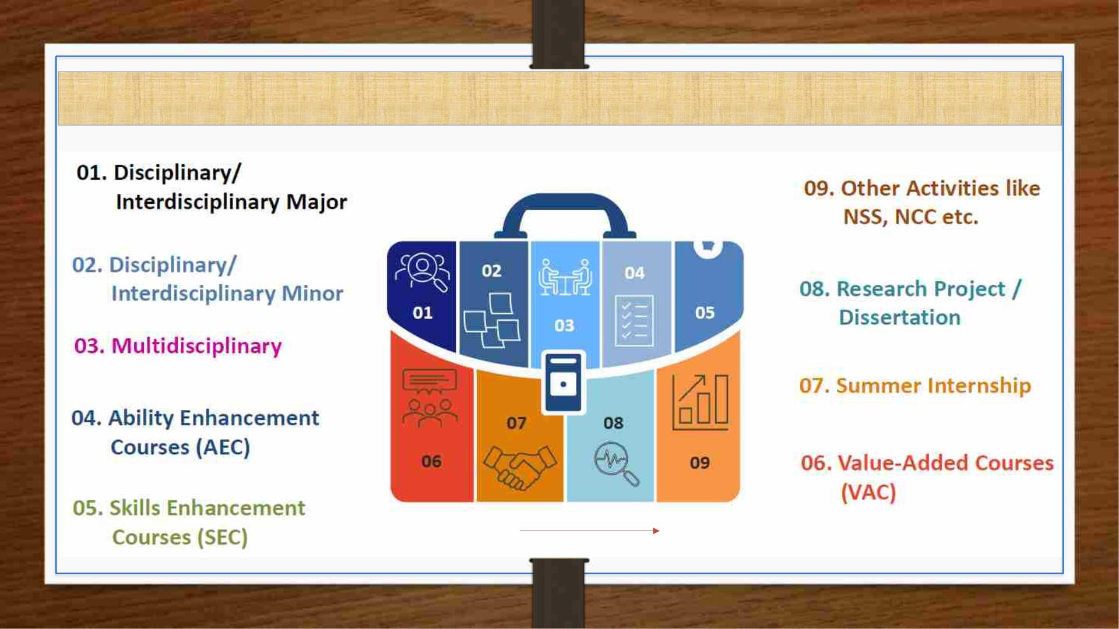
Curricular components of the undergraduate programme

Slide 15

Structure of the Undergraduate Programme
S.N
o
Minimum Credit Requirement
Broad Category of Course
SU-24
AS PER NEP
1
Major (Core)
128
(BS,ES,HS,PC,PE)
80
2
3
Minor Stream
-
32
09
Multidisciplinary
12
(IE,OE)
4
5
6
7
8
Ability Enhancement Courses (AEC)
Skill Enhancement Courses (SEC)
Value Added Courses common for all UG
Summer Internship
-
6
-
08
09
06-08
02-04
12
-
Research Project / Dissertation
14
(Epics, Mini, Major)
Total
160
160

Slide 16

SAHE B.Tech Regulations vs. NEP 2020 Curriculum Guidelines
NEP 2020
Requirement
VRSEC SU24 Technical
Implementation
Gap Identified / Weakness
Strategic Measures & Actions
Open
departments available;
Minor degree structure exists.
Multidisciplinary
Education
electives
from
other Lack of liberal arts integration;
current minors are primarily
STEM-centric.
Introduce electives from
Economics, Political Science, Ethics, Psychology.
Create minors from non-engineering streams.
Multiple Entry/Exit
Options
Certificate (40 Cr), Diploma (80
Cr), B.Tech (160 Cr);
Clearly documented.
No defined tracking system for
students opting out/re-entering.
Create an exit/entry dashboard;
Assign academic advisors for exit path counseling.
Enabled;
SWAYAM/NPTEL accepted;
Up to 20% credit limit (Sec 5.1.6).
Academic Bank of
Credits (ABC)
MOOCs
from
No student-level integration or
interface for ABC credit visibility.
Train students/faculty on ABC.
Integrate LMS with ABC portal.
Offer credit mapping sessions.
Honors and Minor
Degrees
Available with 18–20 additional Only academic-based Honors;
credits. Eligibility: CGPA ≥ 8.0 no research/project-based Honors track
Launch "B.Tech Honors with Research" with structured
UG research credits
(Honours), ≥ 7.0 (Minor).
available.
Flexible Credit Load
and Fast-Tracking
Credit range per semester: 12–24;
fast-track option mentioned (Sec
6.3).
Limited awareness;
no monitoring of fast-track candidates.
Form fast-track advisories.
Allow pre-registration for MOOCs;
Define early graduation criteria formally.
Skill-oriented
projects,
internships included (Sec 5.1.7–
5.1.10).
Skill and Industry-
Oriented
Curriculum
courses, mini-
major projects,
No direct mapping of skill courses
with NSQF job roles or sector
skills councils.
Align skill courses with NSQF levels;
Consult Sector Skill Councils SSCs (e.g., ASDC, ESSCI),
Co-design certification-linked courses with industry
bodies.

Slide 17

SAHE B.Tech Regulations vs. NEP 2020 Curriculum Guidelines
NEP 2020
Requirement
VRSEC SU24 Technical
Implementation
Gap Identified / Weakness
Strategic Measures & Actions
Undergraduate
Research
Opportunities
Final year project is mandatory; No structured long-term UG research
mini-projects exist in earlier track; no research methodology or
Add UG Research Track (CGPA ≥ 8.5); offer Research
Methodology (Sem 3), Literature Review (Sem 5),
Extended Thesis (Sem 7–8).
semesters.
literature review courses.
Outcome-Based
Education (OBE)
COs mapped to POs in each
-
-
-
course;
rubrics
used
for
assessments.
MOOCs &
Lifelong Learning
MOOCs
permitted
via
-
NPTEL/SWAYAM; integrated via
credit substitution (max 20%).
Liberal Arts,
Ethics, Indian
Knowledge
Systems
HSS available as environmental
Add electives in Indian Philosophy, Science &
Society; link to Value-Based Education outcomes
(NEP recommendation).
science,
constitution,
Indian
No diverse liberal arts options;
Knowledge Systems, ethics ,
management.
Multidisciplinary/C
ross-disciplinary
Projects
Final year projects exist but often
restricted within departments.
Lack of inter-department
collaboration or real-world
interdisciplinary challenge focus.
Introduce interdisciplinary final projects (ECE + Mech,
CSE + Civil etc.), incentivize multi-domain team
formations.

Slide 18

Curricular components of the UG as UGC 5.1.3
Courses from Other Disciplines
(Multidisciplinary 9 Credits)
Ability Enhancement
Courses(8 credits
Natural and Physical
Sciences
• Statistics
• Anthropology
• History
Modern Indian Language
(MIL)
• Develop reading and
writing skills
• Learn to express arguments
and thoughts clearly
• Gain awareness of cultural
and intellectual heritage
• Enhance communication,
participation, and
Mathematics, Statistics,
and Computer
Applications
• Linguistics
• Political sciences
• Social work
• Art and creative
writing
• Philosophy
• Gender studies
• Global
English Language
Competency Development
Library, Information,
and Media Sciences
Identity and Knowledge
Mediation
discussion skills
• Build ability to conduct
debates effectively
environment and
health
Commerce and
Management
Critical Thinking and
Expression
Humanities and Social
Sciences
Cultural and Intellectual
Awareness

Slide 19

Curricular components of the undergraduate programme
Value Added Courses
Summer Internship
/Apprenticeship
Skill based courses as per 1.1
Understanding India
(Guidelines for the Introduction of Skill-
based courses and Micro-credentials in
HEIs and SOP for Implementation )
Local industry
Environmental
science/education
Health and allied areas
Local governments
Under
National Higher Education Qualification
Framework ( NHEQF )
Digital and
Media organizations
technological solutions
Artists , Crafts persons
Credit allocation:
Community engagement and
service
Theory: 1 credit = 15 hours
Practical: 1 credit = 30 hours
Experiential learning:
Health & Wellness, Yoga
education, sports, and fitness
Field-based learning/minor project
1 credit = 40-45 hours
Innovative value-added courses
relevant to discipline or common
to all UG programmes
Research Project / Dissertation
Other Activities (NSS,NCC.,)

Slide 20

Award of Accelerated and Extended Degrees by
Higher Education Institutions
Aspect
Accelerated Degree
Extended Degree
Definition
Completing a degree faster than the typical
duration
Taking longer than the usual time to
complete a degree
Eligibility
High-performing or fast-paced learners
Students with constraints, learning
needs, or other reasons
Curriculum/Credits Same total credits
Same total credits
Purpose
Promote academic efficiency and early career
entry
Ensure inclusivity, support diverse
learners
Learning Mode
Intensive schedules, summer/winter terms,
online options
Relaxed pace, remedial support.
NEP Focus
Flexibility, excellence, fast-tracking merit-based
learning
Equity, accessibility, student well-being

Slide 21

Recognition of Prior Learning (RPL)
• Evaluates knowledge gained through formal, non-formal, or informal learning.
• Reduce learning duplication and shortens the time needed for qualification.
• Assessment methods include portfolios, interviews, practicals, and exams.
• Credits awarded may allow advanced entry or course exemptions, with quality assurance
and fairness.
• Applicants submit resumes, certificates, or work samples, and feedback and appeal
options are available.

Slide 22

Review of student club activities and evaluate their impact on
institutional development and student welfare

Slide 23

Student clubs
Clubs are Highly Required
1.Skill Development
2.Professional Networking
3.Student Engagement
4.Placement Impact
5.Innovation & Competitions
6.National Ranking & Accreditation
7.Social Responsibility

Slide 24
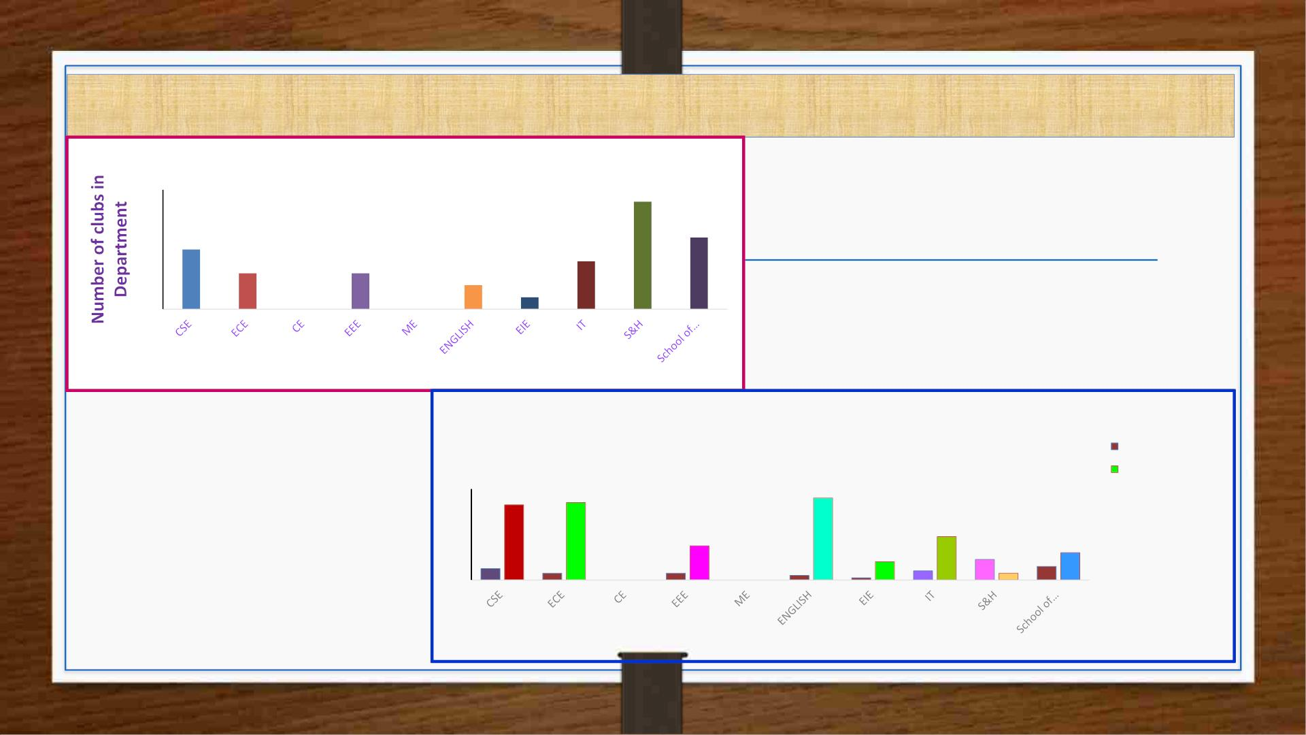
Number of Clubs and its Activities
Number of clubs in Department
10
8
9
6
5
6
4
3
3
4
2
2
1
0
0
0
Department
Number of clubs and total activities by departments
Number of clubs
34
36
Number of activities
40
30
33
15
19
20
5
8
9
6
12
10
0
3
0 0
3
0 0
2
1
4
3
Department

Slide 25

Clubs and its Activities
Total
Number Number
of Clubs of
S. No
Department
Name of the Club
Activities
1
CSE
ECE
CREATIX CLUB, GDG, Elite Coding Club, Elite++,MLSC - VRSEC Chapter
Athisaya Club, Avishkar Club, Vignatha Club
5
3
33
34
2
3
4
5
EEE
Robotics Club, EV Club, Drones Club
Literary Club, Readers’ Club
Spandana Club
3
2
1
15
36
8
ENGLISH
EIE
6
IT
Code chat, AIML Club, Think D, Samskruthi
4
19
JYC, Women Empowerment, Samskruthi Club, Literary Club, Sports Club,
Youth Red Cross, Echo Club
7
S & H
9
3
Pedals Club, Readers Club
8
School of
Management
VR Marketing, VR Finance, VRHR, IIC, General/Non-club specific, VR
Initiators
6
12

Slide 26

Department of CSE
S.No
Name
the Club
of
Objectives
Total
Events
Activities( Summary)
Achievements / Recognitions
Pixel Perfect Workshop – focused on
photography and editing; fostered cross-
Enhanced skills, active student
1
2
3
CREATIX
CLUB
Fosters storytelling and creativity through
photography-based activities.
1
participation,
showcases.
social
media
department
collaboration
and
engagement.
Connects students to explore and grow with
Google technologies.
Flutter Workshop, GDG Inaugural
Seminar, Solution Challenge (I & II
Years), Tech Talks.
Applied to National Google
Solution Challenge.
GDG
4
Organized JAM, Ideathon, quizzes, Internship at Flipkart, 2nd prize in
mock tests, resume building, tech Generative AI Hackathon
sessions, poster presentations, and group (BITS), 1st in Spot Photography
debates. at NeuralTornado.
Elite Coding Encourages coding enthusiasm, teamwork,
Club
17
leadership, and problem-solving skills.
Conducted coding hackathons, mock Students won
national
4
5
Elite++
Focuses on advanced coding skills and
placement readiness via contests.
5
6
interviews/tests, technical sessions (DS, hackathons and secured top-tier
DBMS, OS, CN), and video resume internships at Amazon, Google,
workshops.
Adobe.
MLSC
VRSEC
Chapter
-
Hosted CodeQuest, PowerBI session, Tri
-Lang Quest, Intro to AI on Azure,
300+ participants in CodeQuest,
cross-institution events, 6 prize
winners, 2 Tri-Lang Quest winners.
Builds a consistent and inclusive tech-learning
community for students.
GitHub
Workshop, and
Student
Ambassadors Talk.

Slide 27

Department of ECE
S.N Name of the
Objective
Total
Events
Activities(summary)
Achievements
o
Club
Encouraged
participation
departments in competitive
and creative tasks.
To foster creativity, communication skills,
and critical thinking through competitive
and cultural activities.
Inter Group Quiz, Debate, Essay Writing,
Mock Parliament, Poster Making, Spot
the Lie, Visual Clues
student
across
1
Athisaya Club
7
Enhance core electronics education via
training, innovation, and collaboration with
academia and industry.
Motivational Talk; Ideathon 2024; Secured multiple prizes at
Exposure Visit to MSME Units; Talk on IETE Project Exhibition and
Idea Validation; Visit to STPI; B-Plan Innovation Day 2024. BYST
2
3
Avishkar Club
Vignatha Club
6
Competition
award for Business Idea.
Promoted
Essay Writing, Quiz, Grammar Quest, general
GK Quiz, English Proficiency Quiz, grammar mastery through
communication,
Develop language, communication, and
analytical skills through engaging academic
activities.
knowledge, and
13
Language Olympiad, Word Wizardry
interactive and competitive
formats.

Slide 28

Department of EEE
S.No
Name of the
Club
Objective
Total
Events
Activities (summary)
Achievements
Promote interest in Robotics &
STEM, provide hands-on learning,
Robotics Club develop problem-solving skills,
Uchchaihshrava Agro Pilot
Project for chilli farming-
Development of boats for
weed removal and monitoring
Weekly Training Programs (Sunday
1
2
sessions)-
Collaboration
with
encourage
innovation
and
Peepuls Agri Ventures LLP
collaboration.
Promote green mobility, educate on
EV benefits, workshops on EV
systems, host seminars and
develop EV prototypes.
Hands-on
Training
with Collaborations
with
2
3
EV Club
6
7
SYTIQHUB EV- Workshops on SYTIQHUB and NDEEP
FPGA, Power Converters- Guest CONNECT- Internal student
lectures on EV topics
training and awareness
MOU with Garuda Aerospace
Develop practical drone skills,
National-level Hackathon “The - 16-week internships for 4
Drone Fusion”- 2-day and 4-day students- Developed
Drone Workshops- Industrial Visit- Quadcopter (Petal Copter) and
Guest Lectures- Student Training Hexacopter drones for
promote
drone
use
across
Drones Club
industries, foster research and
collaboration,
development.
and
career
Program
precision agriculture and
delivery

Slide 29

Department of ENGLISH
S.No
Name of the Club
Literary Club
Objective
Total Events Activities (Summary) Achievements
Foster
critical
literature & cultural
appreciation, provide
performance platforms
creativity,
thinking,
Competitions
elocution,
(essay, Promoted literacy,
debates), culture, creativity,
1
2
31
themed
celebrations unity; institutional
(Peace Day, Youth Day, pride via multiple
Heritage Day, etc.)
annual events
Prizes
from
Promote reading habits,
communication, critical
thinking,
Book reviews, donation Chinmaya
Readers’ Club
5
drives,
discussions,
competitions
group Mission, Golden
writing Jubilee
community
through books
participation,
student recognition

Slide 30

Department of EIE
S.No
Name of the Club
Objective
Total Events
Activities (Summary)
Achievements
Develop
creativity,
responsibility,
community
through cultural and literary
activities
soft
skills,
social
Cultural
Fiesta,
Sankranti
Sambaralu, Ugadi Mahotsav -
Competitions: Queen Bee, Fun
Fiesta, Drawing - Teacher’s
Day, National Unity Day
celebrations
1
Spandana Club
and
8
-
engagement

Slide 31

Department of IT
S.No
Name of the
Club
Objectives
Total
Events
Activities (Summary)
Achievements/
Recognitions
Enhance coding skills through
logic,
prepare for contests, peer learning,
and interviews
- High participation (94/107
in Coders-April) - Boosted
1
CodeChef ITVRSEC
competitions,
promote
5
Insightful Quiz - Coders-April - Algorift - Webify -
Regular contests and coding sessions
coding
competitive
awareness
culture and
programming
Teach fundamentals to advanced
AI/ML, hands-on learning, industry
readiness, teamwork, and research
promotion
Quiz Challenge - Beyond the Search Bar (Google
Cloud & Terraform) - Breast Cancer Prediction
with AI - Interactive workshops
- Promoted industry tools and
hands-on AI application
Improved student research
and problem-solving
2
3
AIML Club
Think D
4
3
-
Encourage
innovation,
- Sparked startup ideas and
mentorship
student
potential incubation
Showcased
innovations for
entrepreneurship, interdisciplinary
collaboration, and project funding
Ideathon - INNOVEX - InnoVision
-
- Promoted inclusivity, student
Cypher, Aurora, Nexoria (external fests) - Music unity, and inter-departmental
Maestro, Elocution, Call for Justice - Earth Day, cultural engagement - Raised
Cultural growth, appreciation of arts,
speech fluency, creativity, unity, and
educational enrichment
4
Samskruthi
8
EXCITE, Festive Spirit
awareness and department
reputation

Slide 32

Department of S & H
S.No
Name of the Club
Objectives
Total
Events
Activities (Summary)
Achievements /
Recognitions
1
Jeeyar Youth Club (JYC)
Promote peace, cultural values, service-oriented
mindset among youth
-
No events recorded
—
Women
Empowerment Club
Promote awareness of women's rights, gender
equality, and empowerment through events and
discussions
Awareness building
among first-year students
2
1
Curtain Raiser (11-04-2025)
3
4
5
6
Samskruthi Club
Literary Club
Encourage musical talents, cultural appreciation,
festival celebration, and creative engagement
1
-
SPIC MACAY SRP Classical Series Promoted cultural literacy
(29-03-2025) through classical music
Inspire reading, writing, critical thinking, and literary
discussion among students
No events recorded
—
Sports Club
Promote fitness, team spirit, and sportsmanship
through various athletic competitions and recreation
-
No events recorded
No events recorded
—
Youth Red Cross
Cultivate empathy, community service, and social
responsibility in youth
-
—
Promote environmental awareness and sustainable
practices among students and staff
Earth Day Rally (22-04-2025) from
College to Tadigadapa
Community engagement
environmental
7
Echo Club
1
for
advocacy
8
9
Pedals Club
Encourage cycling as a sustainable, healthy lifestyle and
build a community of cyclists
-
-
No events recorded
No events recorded
—
—
Readers Club
Cultivate reading habits, analytical thinking, and shared
learning through literature

Slide 33

Department of School of Management
S.No Name of the Club
Objective
Total
Events
Activities (Summary)
Remarks
1
2
VR Marketing Club
VR Initiators Club
VR Finance Club
To enhance marketing knowledge and analytical
skills through engaging and competitive events
1
Market Makers Event – Marketing quiz Promoted marketing acumen and
competition
strategy awareness
To promote holistic development through
cultural, communicative, and collaborative
platforms
Workshop on Presentation Skills
MOSAIC: Cultural Fest
Celebrations
Encouraged student participation
Pre-Pongal in soft skills, cultural expression,
and team events
3
-
To foster financial literacy and budgeting skills
among students
Vision 2025: Budget Insights – Financial
budget analysis presentation
Improved financial knowledge
3
4
1
1
and
real-time
budget
interpretation
To empower students with human resource
management insights, focusing on equality and
workplace inclusion
Panel Discussion – Empowering Women in Advocated gender equality and
VRHR Club
Institution’s
Corporate Sector
career empowerment
Vision Pitch 2K25
competition Founders Forge
discussion with entrepreneurs
To promote innovation, entrepreneurship, and
incubation readiness among budding managers
–
Business plan
Cultivated business ideas and
startup thinking
5
6
Innovation
(IIC)
Council
2
–
Panel
General / Department To enhance managerial, entrepreneurial,
Guest lectures, expert talks, round table
-led
specific)
(Non-club analytical, and social responsibility skills among
17
conference, awareness programs, social Supported all-round development
activities (e.g. No Vehicle Day, IPR and industry readiness
Awareness, Budget Analysis, Investiture, etc.)
management students

Slide 34
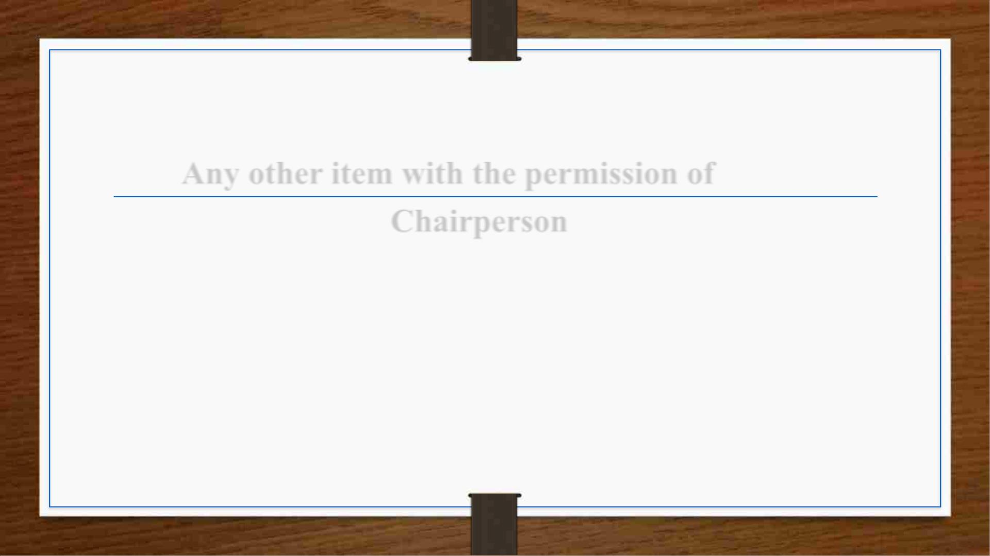
Any other item with the permission of
Chairperson

Slide 35


