Slide 1
WELCOME
21st IQAC Regular Meeting
V.R.SIDDHARTHA ENGINEERING COLLEGE
Wednesday, 30th Dec. 2020
21th IQAC meeting, 30th Dec 2020. V R Siddhartha Engineering College
WELCOME

Slide 2
Agenda
Action taken report on the proposals of 20th IQAC meeting
1. NIRF & ATAL Innovation – for better ranking
2. e – Content development / Lecture capturing system
B) Issues open for discussion
1) Review of Performance Based Appraisal System (PBAS)
2) Alumni identification for their diplomatic involvement in R&D, Consultancy, etc.
3) Any other item with the permission of Chairperson.
21th IQAC meeting, 30th Dec 2020. V R Siddhartha Engineering College
Agenda

Slide 3
A) Action Taken Report on resolutions of 20th IQAC meeting 1. NIRF & ATAL Innovation – for better ranking (Dr B. Srinivas Rao & Dr G. Srinivasa Rao) 2. e – Content development & Lecture capturing system
21th IQAC meeting, 30th Dec 2020. V R Siddhartha Engineering College
Action Taken Report

Slide 4
A) Action Taken Report on resolutions of 20th IQAC meeting
NIRF- Identified Parameters for their improvement
S.No | Parameter | Max Marks | Secured
1 | Publications | 10.5 M | 0.57
2 | Quality publications - Citations | 12 M | 0.60
3 | Patents published & Granted | 4.5 M | 0.30
4 | Sponsored Projects and Consultancy | 3 M | 0.14
5 | Faculty with PhD | 6 M | 3.31
6 | Financial Resources & their Utilization | 9 M | 1.94
7 | Perception | 10 M | 0.27
8 | Placement and Higher Studies | 8 M | 4.24
9 | Median Salary (GMS) | 5 M | 2.18
10 | Economically & Socially challenged students | 2 M | 0.55
21th IQAC meeting, 30th Dec 2020. V R Siddhartha Engineering College
NIRF Ranking

Slide 5
A) Action Taken Report on resolutions of 20th IQAC meeting
Strategies for the improvement of NIRF ranking
Measures initiated for the improvement in NIRF Ranking: R & D - Publications
Brain storming session on the metrics of NIRF was conducted to the Heads of all depts. by Principal & IQAC coordinator.
Interactive Sessions on “Significance of Research & Development in NIRF and selection of Quality Journals” – by Principal & Dr Praveen Naidu.
The Interactive Sessions were organized at three levels of faculty, separately
– Professors, Associate Professors & Asst. Professors
3. The other highlights of Interactive Session in addition to the above are ………
- Expectations of institution from the faculty in view of NIRF
- Facilities provided to faculty to carryout R&D
21th IQAC meeting, 30th Dec 2020. V R Siddhartha Engineering College
NIRF Ranking

Slide 6
Strategies for the improvement of NIRF ranking
Measures initiated for the improvement in NIRF Ranking: R & D - Publications
Last 5 years Publications
Year / Publications | 2014 | 2015 | 2016 | 2017 | 2018 | 2019
SCI & Scopus | 56 | 80 | 75 | 102 | 184 | 277
UGC | 73 | 49 | 85 | 119 | 70 | 3
Total | 129 | 129 | 160 | 221 | 254 | 280
21th IQAC meeting, 30th Dec 2020. V R Siddhartha Engineering College
NIRF Ranking

Slide 7
A) Action Taken Report on resolutions of 20th IQAC meeting
Strategies for the improvement of NIRF ranking
Measures initiated for the improvement in NIRF Ranking: Patents
Institution has been encouraging the faculty to file the patents by providing the financial support.
Guest talks, seminars and FDPs are organizing to inculcate the knowledge about the Patents.
The faculty has trained by IIC – MHRD on “Intellectual Property Rights & Technology Transfer” under Innovative Ambassadors trainings.
Included “Research methodology and IPR” as course in the curriculum to create awareness on IPRs & innovations.
21th IQAC meeting, 30th Dec 2020. V R Siddhartha Engineering College
NIRF Ranking

Slide 8
A) Action Taken Report on resolutions of 20th IQAC meeting
Strategies for the improvement of NIRF ranking
Measures initiated for the improvement in NIRF Ranking: Patents
S. No | Filed | Published | Granted | Total
2014 | 2 | - | -
2015 | 2 | - | -
2016 | 13 | 1 | -
2017 | 5 | 10 | -
2018 | 3 | 8 | -
2019 | 24 | 22 | -
2020 | 30 | 19 | 5
As on date | 14 | 60 | 5 | 79
21th IQAC meeting, 30th Dec 2020. V R Siddhartha Engineering College
NIRF Ranking

Slide 9
A) Action Taken Report on resolutions of 20th IQAC meeting
Strategies for the improvement of NIRF ranking
Measures initiated for the improvement in NIRF Ranking: Perception
A committee is constituted with the following senior faculty by the Principal to take up activities for the enhancement of perception of the institution.
Dr M Padmaja, Dept of EIE
Dr CSS Anupama, Dept of ECE
As a beginning initiative, a Newsletter was designed including the following achievements and circulated to all stakeholders (Industries, Employers, Alumni, Professional societies, Prominent personalities in the country, Parents, others.
21th IQAC meeting, 30th Dec 2020. V R Siddhartha Engineering College
NIRF Ranking

Slide 10
A) Action Taken Report on resolutions of 20th IQAC meeting
Strategies for the improvement of NIRF ranking
Measures initiated for the improvement in NIRF Ranking: Perception
Rankings / Achievements / Recognitions of the Institute & Departments
Major achievements of students including high end placements
Continuous up-gradation of Curriculum to meets the current trends in Industry & Society
Modernization of Laboratories, Collaborative Lab, Centres of Excellence
Up-gradation of Infrastructure / New facilities
Maintenance of Eco friendly campus
21th IQAC meeting, 30th Dec 2020. V R Siddhartha Engineering College
NIRF Ranking

Slide 11
A) Action Taken Report on resolutions of 20th IQAC meeting
Strategies for the improvement of NIRF ranking
Measures initiated for the improvement in NIRF Ranking: Perception
21th IQAC meeting, 30th Dec 2020. V R Siddhartha Engineering College
NIRF Ranking

Slide 12
A) Action Taken Report on resolutions of 20th IQAC meeting
ATAL Ranking of Institutions on Innovations Achievements (ARIIA)
“Band A” - Rank between 6-25 in the category of Private / self- financed Institutes
The metrics for above ranking are …..
Innovations,
Start-ups and
Entrepreneurship.
Further it also depends on ……
Establishment of incubation centres,
Partnership with outside Industries,
Income generation from incubation centres,
Commercialization of start-ups
21th IQAC meeting, 30th Dec 2020. V R Siddhartha Engineering College
ATAL Innovations Ranking

Slide 13
A) Action Taken Report on resolutions of 20th IQAC meeting
ATAL Ranking of Institutions on Innovations Achievements (ARIIA)
‘Innovation → Transformation / new idea / new product / new method’
It will not happen with conventional mind set and instantly
Therefore it is felt that the primary responsibility of the Institute is ….
Changing the attitude & mind set of the faculty & students.
Make them ready by inculcating the knowledge, skills and interest by persistent teachings.
For which Institute Innovation Cell (IIC) was established and many programmes are being organised on regular basis
Dr G Srinivasa Rao & team is working to realise the above objectives
21th IQAC meeting, 30th Dec 2020. V R Siddhartha Engineering College
ATAL Innovations Ranking

Slide 14
A) Action Taken Report on resolutions of 20th IQAC meeting
ATAL Innovations–Activities organised through IIC from the date of 20th IQAC meeting
S. No | Program title | Resource person | Innovation / Start-ups / Entrepreneurship | Participation
 |  |  |  | Student | Faculty
1 | Rural Entrepreneurship Development Cell Action plan in HEI -Workshop | Mr. J. Sai Sudheer Kumar | Innovation | 40 | 10
2 | Innovation day – 15th Oct. | Sri L Srinu, ITS | Innovation | 200 | 70
3 | My Story- Motivational Session by Successful Entrepreneur | Mr.Koka Vinesh Managing Partner at V S Automation | Entrepreneurship | 52 | 5
4 | Launch of KAPILA: Kalam Program for IP Literacy and Awareness of Intellectual Property | Experts from MHRD Innovation Cell. | IPR | 700 | 70
5 | Orientation session on Methods of Exploring & Capturing Values From Indian Agriculture & Health sector | Experts from MHRD Innovation Cell & AICTE | Innovation | 650 | 50
21th IQAC meeting, 30th Dec 2020. V R Siddhartha Engineering College
ATAL Innovations Ranking

Slide 15
A) Action Taken Report on resolutions of 20th IQAC meeting
ATAL Innovations–Activities organised through IIC from the date of 20th IQAC meeting
6 | Implementation of New Education Policy | Dr. R.NataRajan, Former Chairman, AICTE | Innovation | 40 | 130
7 | IUCE -Global Entrepreneurship Education | Sandhya Bala subramanian | Entrepreneur-ship | 150 | 30
8 | International workshop on Development of Intelligent Systems & Smart Devices for Societal Problems (EPICS)” | Experts from UGC, Director of EPICS, PURDUE University, USA, National Institute of Plant Health Management (NIPHM), ISRO | Innovation | 184 | 40
9 | Atma Nirbhar Bharat: The Role of Collabrations | Prof. B.S.Murthy, Director, IIT Hyderabad | Innovation | 110 | 20
10 | IoT Based Technologies | S.GangadharaRao Boppana Co-Founder and CEO of STABILITY, Hyderabad | Entrepreneur-ship | 168 | 28
11 | Design Thinking-1 | Dr. G. SrinivasaRao | Innovation | 348 | 24
12 | IUCEE-UML Global Entrepreneurship Webinar | Chesley Chen shares | Entrepreneur-ship | 150 | 20
21th IQAC meeting, 30th Dec 2020. V R Siddhartha Engineering College
ATAL Innovations Ranking

Slide 16
e-Content development – Recording/Lecturing capturing facility
Current Status:
Room number – 123 of CSE department which has enough space and suitable acoustics has been identified for establishment of the facility.
Currently proposals are invited from external companies regarding internal decoration, procurement of infrastructure and integration of the resources. Budget provisions are currently under review.
Faculty are being motivated to prepare e-Content for their respective subjects and save their recordings so that they can be uploaded once the channel goes public.
Also for easier management of these videos, it is suggested to create a youtube channel for every department such as CSE VRSEC, IT VRSEC as it becomes easier for the students to browse the required content easily.

Slide 17
As of now, we have the following software's available for the faculty to create the lecture videos:
Screen recording software
Zoom Meeting platform
WACOM One by CTL-672/K0-CX Medium 8.5 x 5.3-inch Graphic Tablet
Video editing software
It is proposed to constitute a committee involving both teaching and non-teaching faculty of CSE & IT departments to implement the objectives discussed in the previous IQAC meeting.
As a trail run, one of the faculty member of CSE have created a youtube channel. The link for this channel is:
https://www.youtube.com/channel/UCqQ6FQ62fpld40Jp9BFHtDg

Slide 18
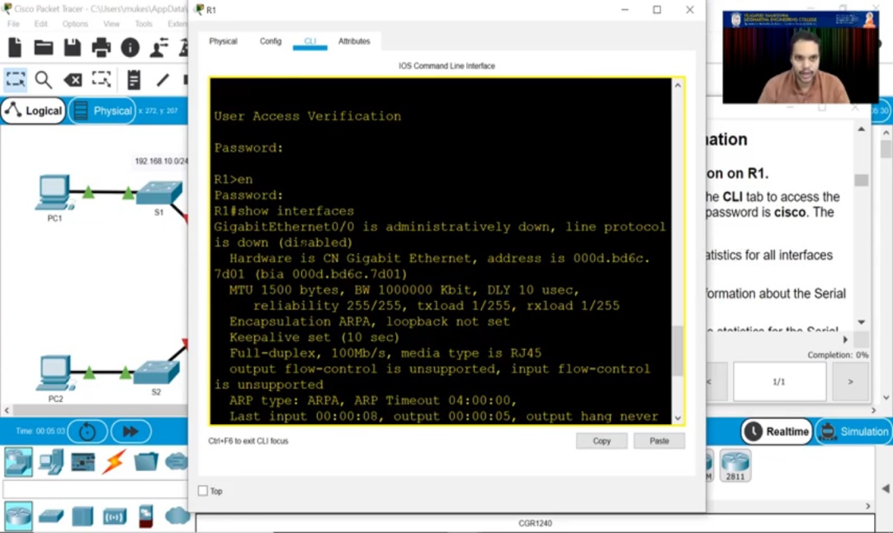
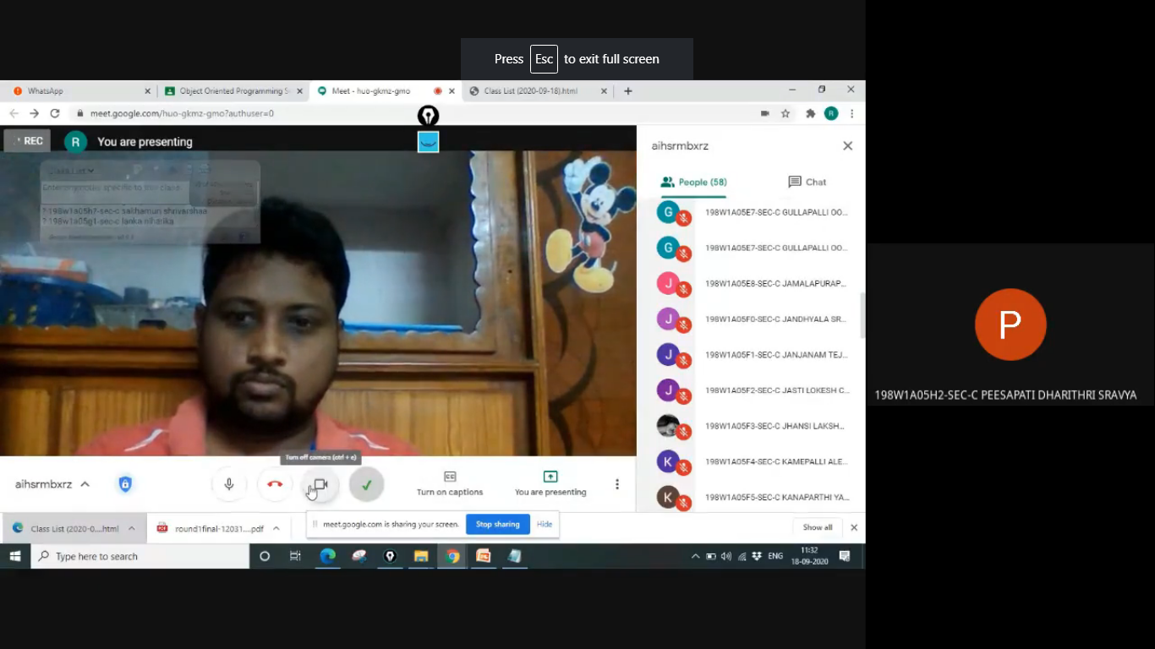
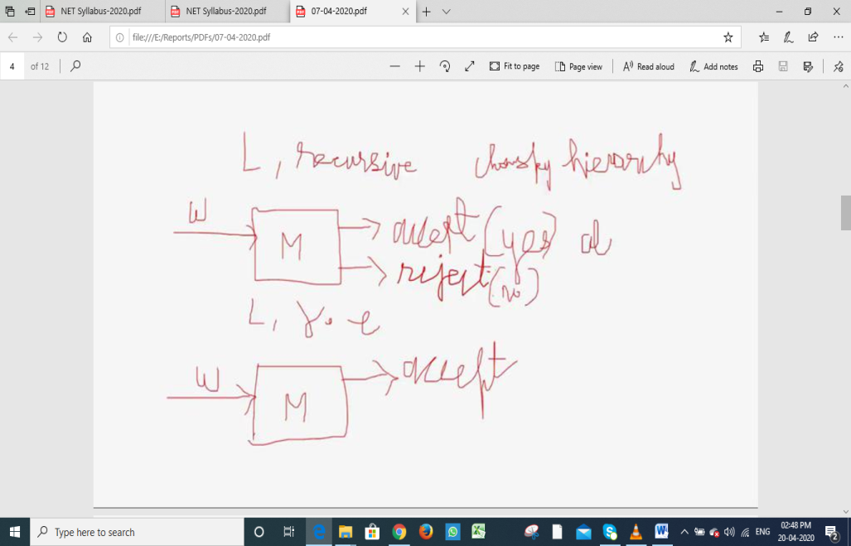

Slide 19
B) Issues open for discussion
1) Review of Performance Based Appraisal System (PBAS)
2) Alumni identification for their diplomatic involvement in R&D, Consultancy, etc.
3) Any other item with the permission of Chairperson.
21th IQAC meeting, 30th Dec 2020. V R Siddhartha Engineering College
Issues open for Discussion

Slide 20
1) Review of Performance Based Appraisal System (PBAS)
About VRSEC-PBAS
Designed to assist both employer and employees in planning, managing, evaluating and realizing
performance & improvement in organization with an aim of achieving organizational goals.
It is implemented since 2013-14 academic year, which is much a head of implementation by NBA
Objectives of the Practice
To identify & distinguish the merit and its encouragement
To measure the performance of employees and help them to improve their potential.
To enhance faculty academic qualifications, knowledge & skills thus to provide quality of teaching.
To enhance the quality of student projects, model developments and Innovations.
For better Industrial and sponsored research projects and quality publications.
Participation and organisation of Conferences / STTP / FDP / Seminars / Workshops.
Participation in Co-curricular, Extra-curricular and administrative activities.
21th IQAC meeting, 30th Dec 2020. V R Siddhartha Engineering College
PBAS

Slide 21
1) Review of Performance Based Appraisal System (PBAS)
Existing Structure of VRSEC-PBAS
 | Parameters | Max Score
 |  | Asst. Prof | Asso. Prof | Prof
1 | Service in the College | 50 | 50 | 75
2 | Curricular | 600 | 400 | 350
3 | Co - Curricular | 100 | 150 | 150
4 | R & D * (Min. Requirement) | (30)/150 | (50)/250 | (60)/300
5 | Extra-Curricular & Admin. duties | 100 | 150 | 125
 | GRAND TOTAL | 550/1000 | 550/1000 | 550/1000
21th IQAC meeting, 30th Dec 2020. V R Siddhartha Engineering College
PBAS

Slide 22
Existing Structure of VRSEC-PBAS
Part-I CURRICULUM - TEACHING & LEARNING PROCESSES - Professors
S.No | Parameters | Max Score
1.1 | Teaching Weekly Load | 40
1.2 | Lectures Taken/Lectures Planned | 20
1.3 | Course Files | 50
1.4 | External Exam /Evaluation Duties | 20
1.5 | Internal Exam /Evaluation Duties | 10
1.6 | Innovative Teaching Methodologies | 50
1.7 | Remedial / Bridge / Content Beyond Syllabus | 20
1.8 | Counseling Records | 30
1.9 | Pass Percentage | 30
1.10 | Student Feedback on Teaching | 30
1.11 | Project Guidance | 50
1.12 | Feedback on Project Guidance | 20
1.13 | NPTEL… course with online Exam | 30
1.14 | Involvement of Faculty in syllabus framing | 30
PART – 1 TOTAL |  | 350
21th IQAC meeting, 30th Dec 2020. V R Siddhartha Engineering College
PBAS

Slide 23
1) Review of Performance Based Appraisal System (PBAS)
Existing Structure of VRSEC-PBAS
Part - 2 CO-CURRICULAR -TEACHING & LEARNING PROCESSES - Professors
S.No | Parameters | Max Score
1 | Membership of professional societies | 20
2 | Contribution in providing Departmental facilities | 20
3 | Participation in FDPs | 50
4 | Guest Lecturers attended | 40
5 | Accompanied Students on Industrial tours | 10
6 | Students Techno fest (AFOSEC) | 20
7 | Student Innovations guidance | 30
8 | Consultancy | 40
9 | Arranging Internships for students | 30
10 | Knowledge sharing with other departments | 30
 | PART - 2 TOTAL | 150
21th IQAC meeting, 30th Dec 2020. V R Siddhartha Engineering College
PBAS

Slide 24
1) Review of Performance Based Appraisal System (PBAS)
Existing Structure of VRSEC-PBAS
PART - 3 R & D RELATED CONTRIBUTIONS - Professors
S.No | Parameters | Max Score
1 | Publications | 80
2 | Sponsored Research Projects | 100
3 | Papers presented in seminars/ conferences | 50
4 | Patents | 100
5 | Incubation centers established | 50
6 | Centre of excellence established | 50
7 | Ph D Guidance | 50
8 | Project guidance to PG students | 70
 | PART – 3 TOTAL | 300
21th IQAC meeting, 30th Dec 2020. V R Siddhartha Engineering College
PBAS

Slide 25
1) Review of Performance Based Appraisal System (PBAS)
Existing Structure of VRSEC-PBAS
Part - 4 ACADEMIC ADMINISTRATION, INSTITUTIONAL DUTIES - Professors
1 | Department Administration | 40
2 | Institutional level administration | 80
3 | Institutional Events - organization members | 50
4 | NSS / NCC Activities / Societal Contributions | 20
5 | Training & Other Miscellaneous Activities | 30
 | PART-4 TOTAL | 125
21th IQAC meeting, 30th Dec 2020. V R Siddhartha Engineering College
PBAS

Slide 26
1) Review of Performance Based Appraisal System (PBAS)
Changes in PBAS to meet the current requirements
IQAC is proposed to make some changes in PBAS according to the metrics of National quality certifying agencies, by the directions of Principal.
It is proposed to remove / reduce the marks of the below metrics from ‘minimum marks requirement in R & D’. But they are considered for ‘overall minimum marks requirement’.
Reviewer of journal Paper
Sponsored research Projects – submitted but awaiting sanction
Joint Collaborative Projects - submitted but awaiting sanction
Chairing sessions on invitation
Invited speaker on invitation
Keynote Speaker
21th IQAC meeting, 30th Dec 2020. V R Siddhartha Engineering College
PBAS

Slide 27
Changes in PBAS to meet the current requirements
Every faculty should involve in at least three of the following, in every academic year
21th IQAC meeting, 30th Dec 2020. V R Siddhartha Engineering College
PBAS

Slide 28
B) Issues open for discussion
2) Alumni identification for their diplomatic involvement in R&D / Consultancy / Placements / Internships …..
The Institute is searching every corner for resources to enhance the quality and participate in today’s competitive world.
The biggest asset of the Institution is Alumni
VRSEC – Alumni cell is in operation, Dr N Ravi Kumar is looking after it.
But the idea behind the agenda item is further how best their services can be utilized.
It is decided to identify the alumni and make use of them for the progress of Institution.
21th IQAC meeting, 30th Dec 2020. V R Siddhartha Engineering College
Alumni identification & their diplomatic involvement

Slide 29
2) Alumni identification for their diplomatic involvement in R&D / Consultancy / Internships / Placements ….
Some of the Prominent Alumni
S.NO | NAME | DESIGNATION | COMPANY
1 | Mr. Mohan Nannapaneni Civil Engg. | Co-Founder and Chief Executive Officer, Sigma Systems. | TANA-Telugu Association of North America
2 | Prof. Ranganadha Vemuri ECE | Professor & Head VLSI | University of Cincinnati, USA
3 | Dr. S. Srinivas Kumar ECE | Vice Chancellor | JNTU - Ananthapur
4 | Dr L. Krishnanand Mechanical Engg. | Professor | NIT - Warangal
5 | Dr. Y. K. D. V. Prasad Mechanical Engg. | Professor in Smart Systems, Project Director: Airports of the Future | Queensland University, Brisbane, Australia
6 | Mr. Lagadapati Madhusudhan Mechanical Engg. | Chairman | LANCO Group
21th IQAC meeting, 30th Dec 2020. V R Siddhartha Engineering College
Alumni identification & their diplomatic involvement

Slide 30
2) Alumni identification for their diplomatic involvement in R&D / Consultancy / Internships / Placements ….
Some of the Prominent Alumni
7 | Srinivas Aravapalli ME | Sr. Vice President, Head-Product Development | Automotive Division Mahindra & Mahindra, Channia
8 | Mr. Apparao Venkata Varre Civil | Executive Vice President, Global Delivery Head | Banking, Financial Services & Insurance HCL Technologies
9 | Mr. Kaiser Adeni ECE | Senior Technical Advisor | NASA Management Office(NMO) at the Jet Propulsion Laboratory
10 | Mr. Regi Vergeese EEE | Country Head | Delphi Systems India Pvt. Ltd., New Delhi
11 | Mr. Sajja Kishore Babu ME | Chairman & Managing Director | Power Mech Projects Limited Madhapur, Hyderabad
12 | Mr. Siva Linga Prasad Panda ME | MLA for Calgary-Footthills | Edmonton, AB, Canada T5K 1E7
13 | Sri Rama Malladi EEE | University Professor | California University
21th IQAC meeting, 30th Dec 2020. V R Siddhartha Engineering College
Alumni identification & their diplomatic involvement

Slide 31
2) Alumni identification for their diplomatic involvement in R&D / Consultancy / Internships / Placements ….
Some of the Prominent Alumni
14 | Venkat R Gajjala B.Tech | Vice President, Head-Product Engineering Group | Tech Mahindra, Hyderabad
15 | Mr. K. Veera Raghava Rao, IAS CSE | District Collector | Madurai, Tamilnadu
16 | Mr. N. Bala Subramanyam, IPS EEE | Transport Commissioner | A.P.
17 | Mr. Lagadapati Rajagopal ME | Ex. Member of Parliament | Vijayawada
18 | Mr. Rajendra Velagapudi ME | Sr. Vice President Global Delivery Head-Aerospace | Cyient Technologies, Hyderabad.
19 | Gopalam Gopinath ME | CEO | Apollo Behavioral Health Hospital, Louisiana, USA
20 | Venu Priya Nadendla ECE | Founder & CEO | Janyaa.org &PMO Paypal, San Francisco Bay Area
21 | S. B. Sanjay Kumar EEE | CEO&MD | Elior Companies India IRMA, Bangalore, Karnataka, India
21th IQAC meeting, 30th Dec 2020. V R Siddhartha Engineering College
Alumni identification & their diplomatic involvement

Slide 32
2) Alumni identification for their diplomatic involvement in R&D / Consultancy / Internships / Placements ….
Some Alumni Contributions
PLACEMENTS
Sri K.R.K.Raju, Chief Project Manager - Rail Vikas Nigam Limited - 9
Sri V. Visweswara Rao - Contech Syndicate Private Limited – 14
Sri Koya Srinivasa Rao - Amerigo Structural Engineers Private Limited - 15
Sri K.Sambasiva Rao - R.N. Constructions - 5
Sri Sajja Kishore babu-Power Mech Projects Limited - 30 (ME&CE)
Sri Koya Srinivasa Rao - donated Rs.5 Lakhs for conducting endowment lectures
21th IQAC meeting, 30th Dec 2020. V R Siddhartha Engineering College
Alumni identification & their diplomatic involvement

Slide 33
2) Alumni identification for their diplomatic involvement in R&D / Consultancy / Internships / Placements ….
Some Alumni Contributions
R & D PROJECTS / CONSULTANCY / INTERNSHIPS
R & D Projects – 5 Lakhs - Received & completed through Sri KRK Raju, RVNL
R & D Projects – 4 Lakhs - Received & completed through Sri KRK Raju, RVNL
R & D Projects – 20 Lakhs - In the process of getting through Sri KRK Raju, RVNL
Consultancy – 4 Lakhs – Sri V.Visweswara Rao, Contec Syndicate Pvt Ltd
Consultancy – 1 Lakh – Sri Nagabhushanam - Nagabhushanam Company & Co.
Internships – 35 - Sri M.Subba Rao,Badri Builders; Sri A. Siva Rama Krishna, Vijaya Raja Rajeswari Constructions; Sri Sajja Kishore Babu, Power Mech Infra Ltd., Koya Srinivas, Amerigo, Bangalore
21th IQAC meeting, 30th Dec 2020. V R Siddhartha Engineering College
Alumni identification & their diplomatic involvement

Slide 34
2) Alumni identification for their diplomatic involvement in R&D / Consultancy / Internships / Placements ….
Mechanism of Identifying potential alumni
Strengthening of existing alumni cell at institute level with a coordinator and Principal as chairman.
Strengthening of existing alumni cell at department level with a coordinator and HOD as chairperson.
Defining Responsibilities - Batch wise collection & maintenance of data bank with all necessary details. - Monthly schedule of various activities to be organized at department level and institute level utilizing their services. - Periodic communication of Institute information - Setting monthly / Yearly targets at department level and institute level.
21th IQAC meeting, 30th Dec 2020. V R Siddhartha Engineering College
Alumni identification & their diplomatic involvement

Slide 35
2) Alumni identification for their diplomatic involvement in R&D / Consultancy / Internships / Placements ….
Identification of potential alumni-Mechanism
Identification and segregation of alumni as per the institute requirement
Interaction with available identified alumni by inviting them at various occasions of the Institute / by other ways
Periodical communication of college information / achievements to maintain cordial relations
Submitting monthly dept. level progress to Institute level Alumni Cell & Principal.
21th IQAC meeting, 30th Dec 2020. V R Siddhartha Engineering College
Alumni identification & their diplomatic involvement

Slide 36
Any other item with the permission of Chairman
21th IQAC meeting, 30th Dec 2020. V R Siddhartha Engineering College
Any other item

Slide 37
21th IQAC meeting, 30th Dec 2020. V R Siddhartha Engineering College
21th IQAC meeting, 30th Dec 2020. V R Siddhartha Engineering College
16th IQAC meeting, , 15th June 2019. V R Siddhartha Engineering College

