Slide 1
Smart Energy Homes
Vishal Garg
Head, Center for IT in Building Science
International Institute for Information Technology Hyderabad

Slide 2
David Epstein-- Range: Why Generalists Triumph in a Specialized World
In this landmark book, David Epstein shows that the way to succeed is by sampling widely, gaining a breadth of experiences, taking detours, experimenting relentlessly, juggling many interests – in other words, by developing range
Do we really need to go through courses with very specialized knowledge that often provides a huge amount of stuff that is very detailed, very specialized, very arcane, and will be totally forgotten in a couple of weeks? Especially now, when all the information is on your phone. We don’t train people in thinking or reasoning

Slide 3
A course titled “How Do We Know What Is True?” examines types of evidence through history and across disciplines. In “Anatomy of Scientific Error,” students are detectives, hunting for signs of misconduct or poor methods in real research, while also learning how errors and serendipity have led to momentous discoveries
A program, known as the R3 Initiative (Rigor, Responsibility, Reproducibility), starts with interdisciplinary classes that include philosophy, history, logic, ethics, statistics, communication, and leadership

Slide 4
What is a smart energy home?
Smart homes use internet-connected devices to enable remote monitoring and management of appliances and systems, such as temperature, lighting, and security cameras. Smart energy homes take a step beyond the gadget-filled smart home to focus on bringing smart functionality to major household energy-using systems such as HVAC, water heating, and plug loads (including appliances and electronics)
Source: Northeast Energy Efficiency Partnerships

Slide 5
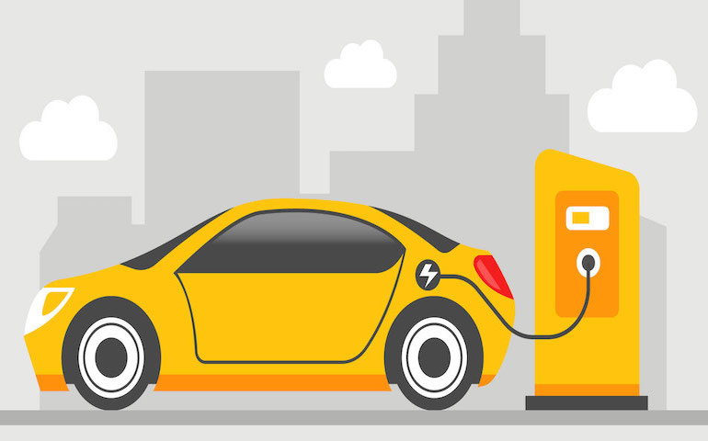
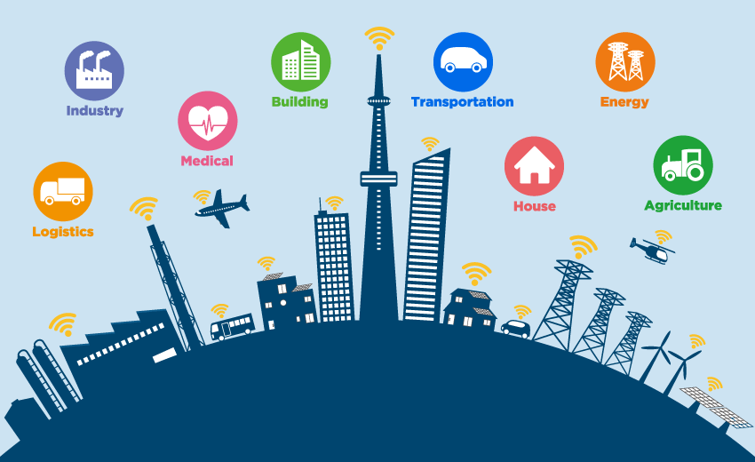
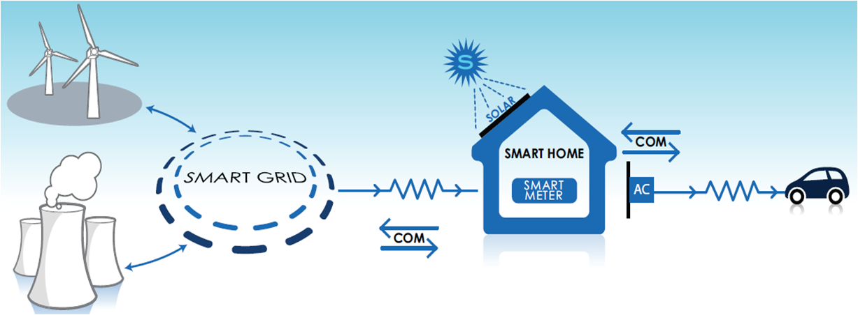
Smart Homes: Need & Readiness
Rapid technology development and adoption of
Renewable Energy
Electric Vehicles
Has resulted in a revolution towards the establishment of
Smart City
Smart Grid
https://autotechreview.com/siemens-automotive-engineering-simulation-and-automation-test-center/technology-and-innovation/top-10-electric-vehicle-manufacturers-in-india-their-innovations
https://medium.com/@thinkwik/why-people-are-talking-so-much-about-iot-is-iot-really-future-74d5008fe2af
https://iiot-world.com/ics-security/cybersecurity/renewable-resources-can-increase-cyber-threats/
https://www.voltimum.co.uk/articles/building-automation-key-successful
https://riberasolutions.com/smart-city-iot-and-ai/
Notes:
Need and readiness for smart homes.
Rearrange and make it catchy.

Slide 6
Drivers
Availability of Do It Yourself (DIY) kits
Easy implementation of Artificial Intelligence
Drivers enabling home automation
Rising disposable incomes
Penetration of Internet of Things as a technology
Affordable smart home products
Accessibility to cloud computing

Slide 7
Barriers
Price
Data security
Privacy
59% of people agree that technology cost is a major barrier in the smart home automation sector
46% think that data security and cyber risks are the second most challenging issue for the sector
35% thinks consumer perception and privacy issue as one of the major barriers
Service infrastructure
Interoperability
24% of respondents think that service infrastructure needs to evolve
24% of people believe that lack of compatible ecosystem is a barrier for widespread adoption of home automation systems
Adopted from presentation made by Deloitte as a part of BEE - GIZ project titled "Smart Home Technology Assessment and Pilot Design" Study.

Slide 8
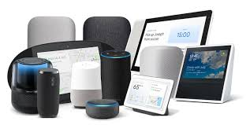
Technology and Market Trends
Technology and market trends
Entry point devices - Voice controlled speakers, routers, Set-top boxes
Smart homes as a service
Standard fitment
Standardization and interoperability
Artificial Intelligence
Chatbots
Energy harvesting
Smart gadgets have entered homes through devices such as routers, set-top boxes and voice-controlled speakers
Connectivity, communication and entertainment are the drivers
Wi-Fi routers (Samsung SmartThings V3) and Set-top boxes (Cox Communications and Comcast) are becoming Smart home hubs

Slide 9
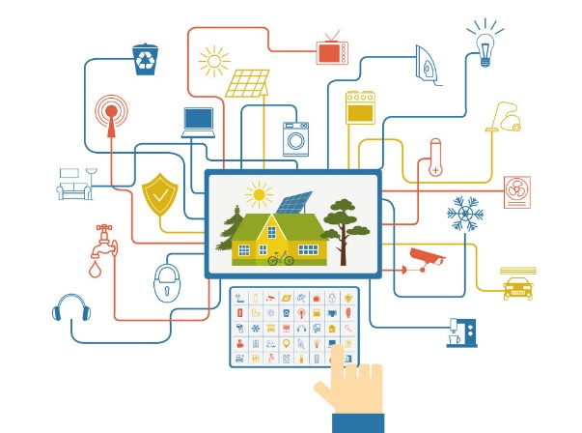
Technology and Market Trends
Technology and market trends
Entry point devices - Voice controlled speakers, routers Set-top boxes
Smart homes as a service
Standard fitment
Standardization and interoperability
Artificial Intelligence
Chatbots
Energy harvesting
Driven by utilities, telecoms and cable network providers
Devices are just the components; it is the service that matters
Single app that can manage the entire suite of home services with a common user interface
Evolving hardware ownership models which avoid technology obsolesce

Slide 10
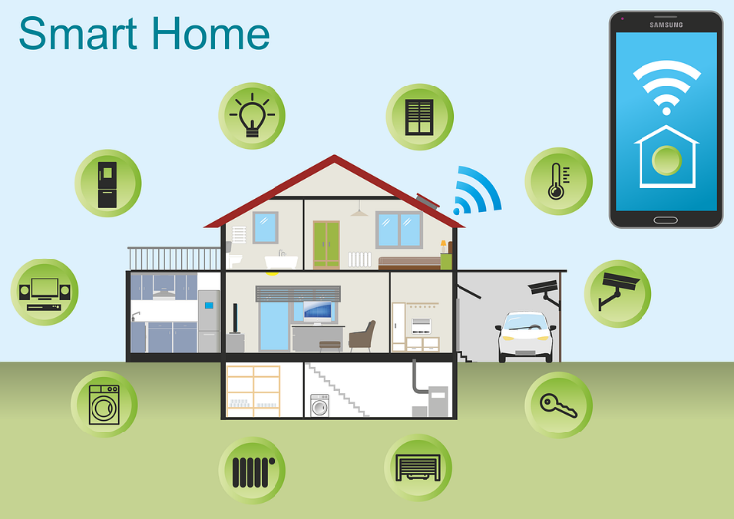
Technology and Market Trends
Technology and market trends
Entry point devices - Voice controlled speakers, routers Set-top boxes
Smart homes as a service
Standard fitment
Standardization and interoperability
Artificial Intelligence
Chatbots
Energy harvesting
Home automation is being conceived as a standard fitment in new homes
Builders are showing interest and offering Smart Homes

Slide 11
Technology and Market Trends
Technology and market trends
Entry point devices - Voice controlled speakers, routers Set-top boxes
Smart homes as a service
Standard fitment
Standardization and interoperability
Artificial Intelligence
Chatbots
Energy harvesting
OCF and oneM2M have developed harmonized standards to permit seamless interworking between oneM2M and OCF environments
Matter, is a smart home connectivity standard. The new protocol is backed by Apple, Google, Amazon, and some other big names in the Connectivity Standards Alliance to increase interoperability between smart home devices across platforms

Slide 12
Technology and Market Trends
Technology and market trends
Entry point devices - Voice controlled speakers, routers Set-top boxes
Smart homes as a service
Standard fitment
Standardization and interoperability
Artificial Intelligence
Chatbots
Energy harvesting
Artificial Intelligence is catching up to automate most actions compensating for the need for user feedback or control

Slide 13
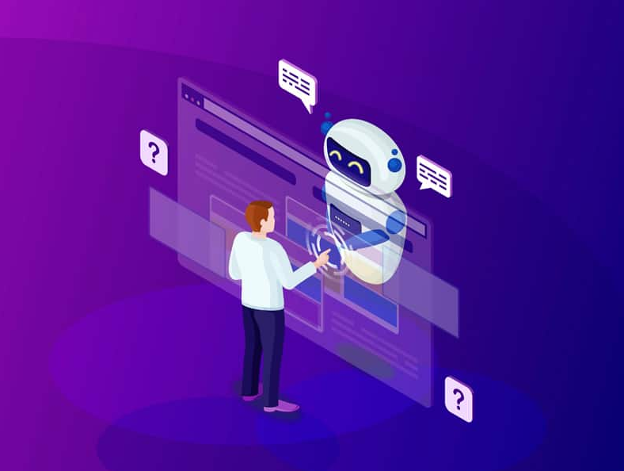
Technology and Market Trends
Technology and market trends
Entry point devices - Voice controlled speakers, routers Set-top boxes
Smart homes as a service
Standard fitment
Standardization and interoperability
Artificial Intelligence
Chatbots
Energy harvesting
ChatBots allow hands free easy communication in their natural language, and a perfect future solution for easy remote access to smart homes with privacy
ChatBots are emerging as a mode of customized interface, simplifying interfacing and making it more universal

Slide 14
Technology and Market Trends
Technology and market trends
Entry point devices - Voice controlled speakers, routers Set-top boxes
Smart homes as a service
Standard fitment
Standardization and interoperability
Artificial Intelligence
Chatbots
Energy harvesting
Energy Harvesting, ultra-low power devices, long range wireless charging are gaining popularity as Technologies for low power consumption have become important for ensuring longer life for batteries

Slide 15
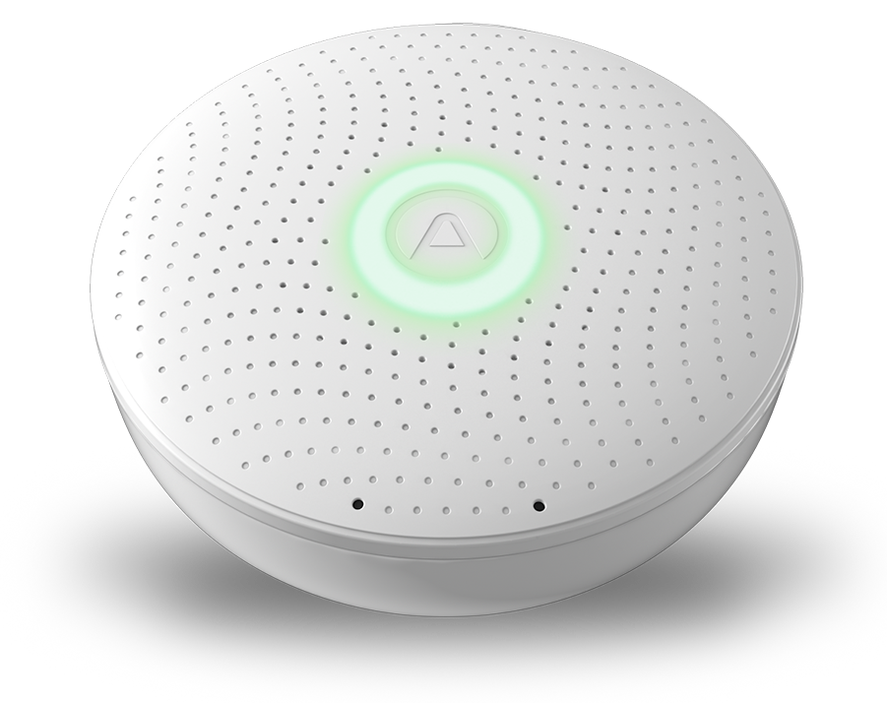
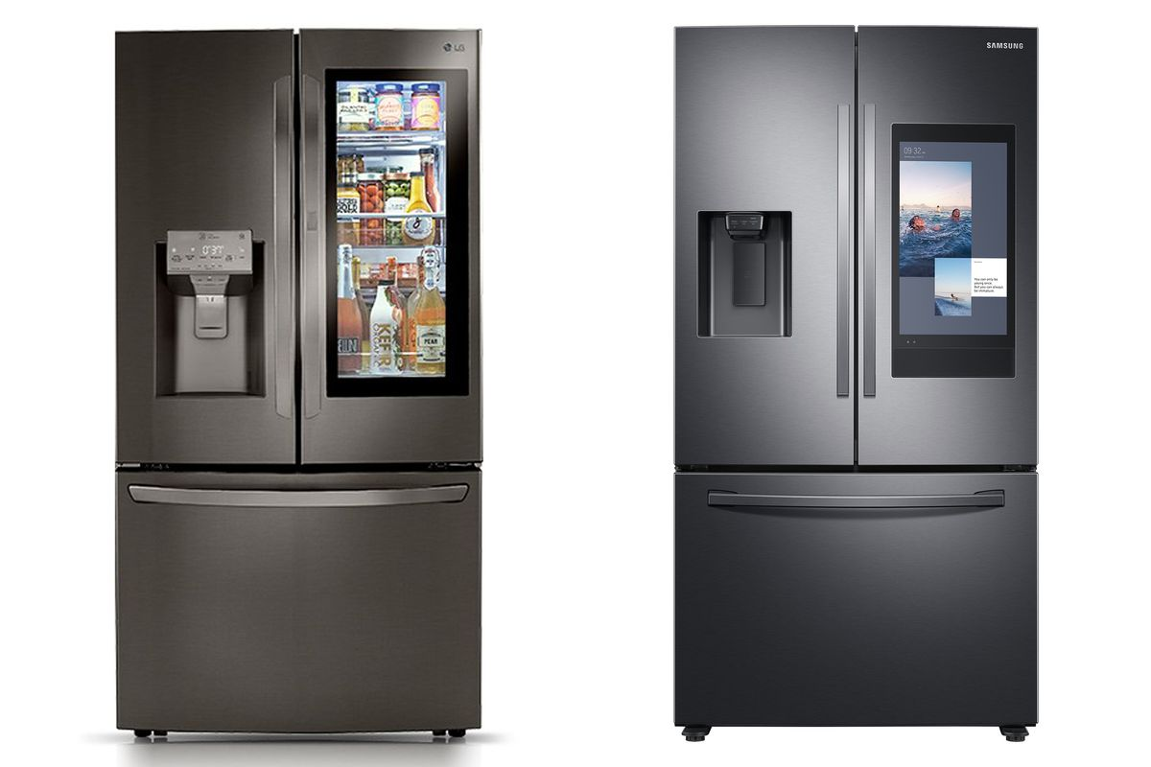
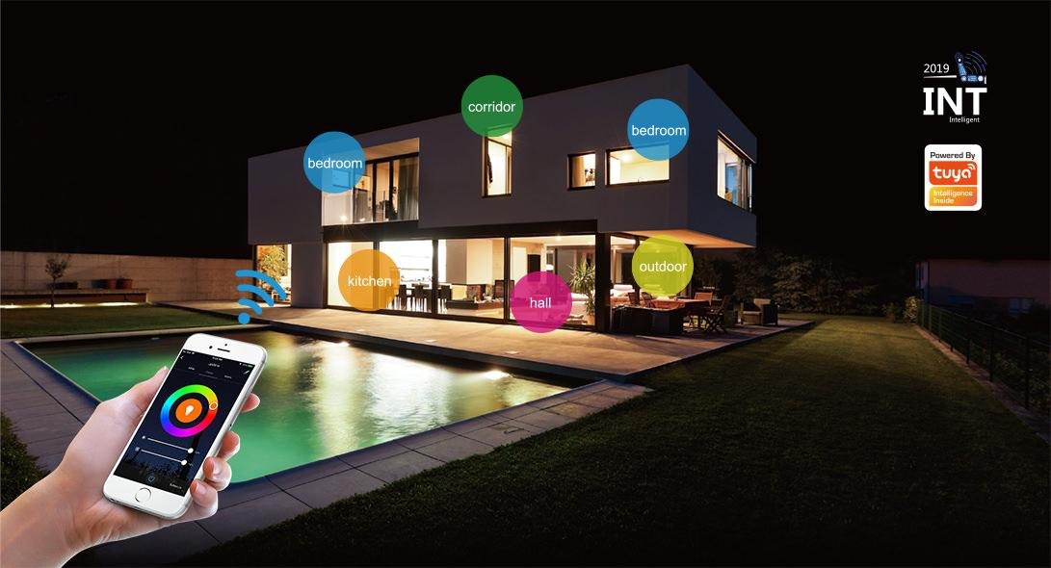
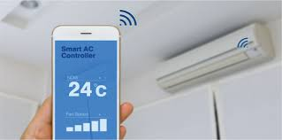
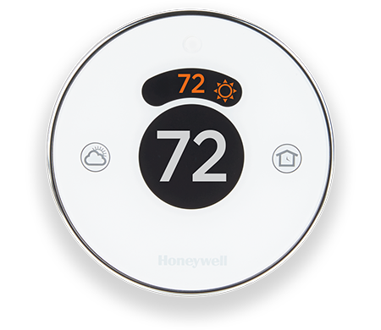
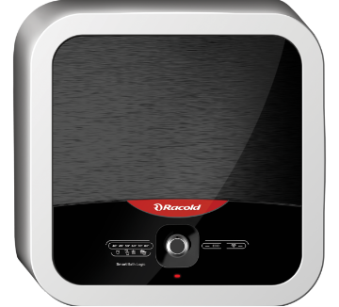
Smart Appliances
Smart Blinds
Smart IAQ Device
Smart Refrigerator
Smart Lights
Smart Air Conditioner
Smart Thermostat
Smart Washing Machine
Smart Geyser
https://www.alliedmarketresearch.com/smart-connected-washing-machine-market
https://www.racold.com/electric-storage-geyser/omnis-wifi
https://www.samsung.com/in/refrigerators/french-door/810l-black-stainless-rf28n9780sg-tl/
https://time.com/4318290/samsungs-smart-refrigerator-family-hub/
digitaltrends.com/home/best-smart-blinds/
123rf.com/photo_70900755_iot-concept-remotely-controlling-smart-air-conditioner-with-app-on-smartphone.html
https://www.airthings.com/en/wave-plus
greentechmedia.com/articles/read/Honeywell-Launches-Glossy-Thermostat-Lyric
Notes:
Use this slide

Slide 16
RESEARCH @ IIITH

Slide 17
Design & trial of SHEMS
Residential Building Energy Demand Reduction in India (RESIDE)
An Indo-UK research project
Design of a simple Smart Home Energy Management System (SHEMS)
Deployment in 200 homes for 12 months for socio technical analysis
Developing load profiles for energy simulation models
Impact of the following on users energy consumption behaviour
Energy feedback
Normative feedback
Energy saving tips
Control and automation
Time varying tariff

Slide 18
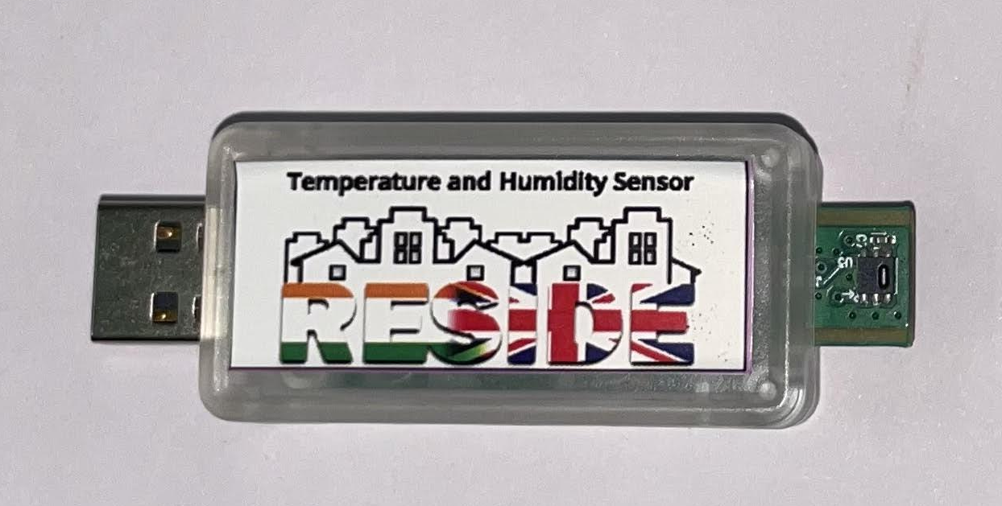
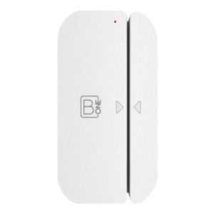
Components of Smart Home Energy Management System
1. Energy Meter
Enables monitoring & budgeting of energy loads
Gives real-time data on running & standby loads of appliances
AI enabled NILM for load detection, optimization & preventive maintenance of appliances
Provides data on consumption and generation of alternate power
3. Temperature Humidity Sensor
Monitors temperature and humidity
4. Smart Socket
Enables energy monitoring
Appliance on-off scheduling
Remote control using App
2. Window open/close sensor
Provides real-time alerts on open and close state of the door, has a tamper switch to notify any tampering
5. IR Emitter
Actions can be set to automate activities combining IR and Wi-Fi devices
Controls can be accessed by App, Voice or ChatBots, supports devices from anywhere in the world.

Slide 19
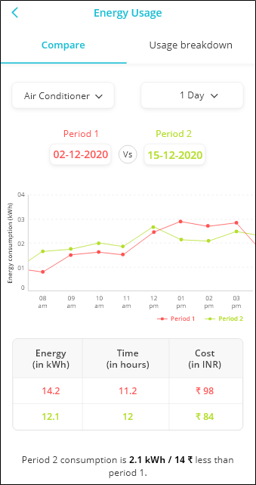
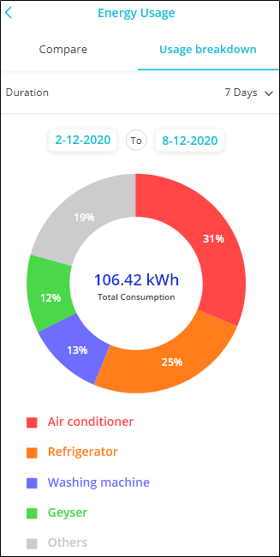
SHEMS Trails
Energy Feedback
Information on weekly/monthly power consumption with trend analysis over time
Possibility of remote/schedule-based/occupancy-based switching of devices
Time-varying tariffs
Feedback on appliances consuming most power and suggestions. Normative feedback which needs data over time
Comparison of energy consumption with other households of similar nature and locations

Slide 20
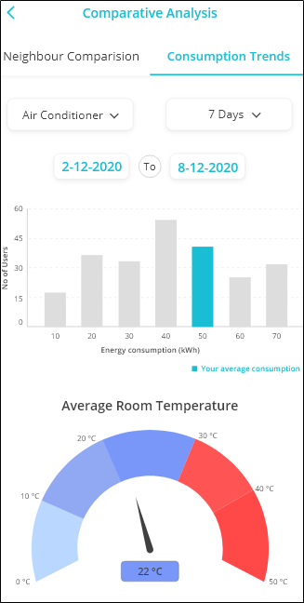
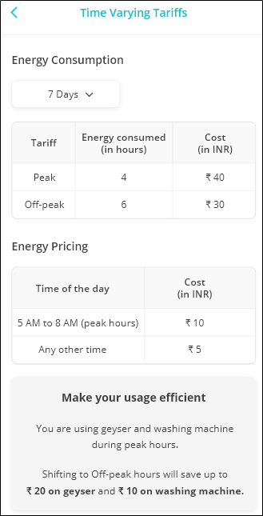
SHEMS Trails
Normative Feedback
Time-varying Tariff
Information on weekly/monthly power consumption with trend analysis over time
Possibility of remote/schedule-based/occupancy-based switching of devices
Time-varying tariffs
Feedback on appliances consuming most power and suggestions. Normative feedback which needs data over time
Comparison of energy consumption with other households of similar nature and locations

Slide 21
Energy Feedback
Feedback has been studied as a strategy for promoting energy conservation*
*Karlin, B., Zinger, J. F., & Ford, R. (2015). The effects of feedback on energy conservation: A meta-analysis. Psychological Bulletin, 141(6), 1205–1227. https://doi.org/10.1037/a0039650

Slide 22
Duration of feedback
What happens if energy feedback is provided for several years?

Slide 23
Duration of feedback
It has been seen that feedback becomes less effective over time
Findings indicate the near complete abandonment of the devices about 10 years after the initial deployment of IHD’s*
*Stephen Snow, Stephen Viller, Mashhuda Glencross, and Neil Horrocks. 2019. Where Are They Now? Revisiting Energy Use Feedback a Decade After Deployment. Proceedings of the 31st Australian Conference on Human-Computer-Interaction. Association for Computing Machinery, New York, NY, USA, 397–401. DOI:https://doi.org/10.1145/3369457.3369501

Slide 24
Frequency
How frequently would you like to receive feedback on your energy consumption?
Real time
Hourly
Daily
Weekly
Monthly

Slide 25
Frequency
The optimal frequency of sharing feedback and strike a balance between the basic needs of acquiring information and emotional response (to the interface interaction), such as annoyance or pleasure. This is important since it demands empathy, an aspect that plays an important role in user engagement and is a core of usability and user experience*
*Putnam, C., & Kolko, B. (2012). HCI professions: differences & definitions. In CHI'12 Extended Abstracts on Human Factors in Computing Systems (pp. 2021-2026

Slide 26
Reporting
In which of the below terms would you prefer to receive energy feedback
kWh
Cost
CO2

Slide 27
Messaging Style
Which style of presenting information on energy consumption would you prefer-
Personal
Impersonal

Slide 28
Type of feedback
Would you prefer getting simple feedback or actionable feedback?

Slide 29
Normative feedback
Will the information on energy consumption of your neighbor motivate you to save energy?

Slide 30
Normative feedback
Households receiving the normative frame consumed 9% less than control households during the initial 1-week evaluation period, and 7% less during the full 3-month evaluation period*
*Schultz, Paul & Estrada, Mica & Schmitt, Joseph & Sokoloski, Rebecca & Silva-Send, Nilmini. (2015). Using in-home displays to provide smart meter feedback about household electricity consumption: A randomized control trial comparing kilowatts, cost, and social norms. Energy. 90. 10.1016/j.energy.2015.06.130.
Notes:
Age and preference of normative feedback

Slide 31
Gamification and Serious Games
Serious games are games that have been designed for a primary purpose other than pure entertainment
Gamification, on the other hand, is the application of typically game-like elements to other areas of activity such as marketing or training in order to increase engagement and effectiveness

Slide 32
Gamification and Serious Games
Do you think games can help in saving energy?

Slide 33
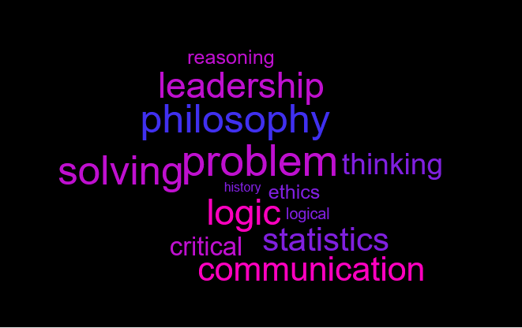

Slide 34
Thank you vishal@iiit.ac.in
Thanks to Rishika Agarwal for preparing the PPT

